Slide 1
Selecting an Initial ART Regimen
www.hivguidelines.org

Slide 2
Purpose of This Guideline
Provide a clear and concise roadmap for clinicians to follow in choosing from among several equally efficacious ART regimens based on individual patient characteristics and preferences.
Provide a list of ART regimens to avoid.
Provide dosing considerations for individuals with renal or hepatic impairment and important drug-drug and food interactions.
Encourage clinicians to seek the assistance of an experienced HIV care provider when treating patients with extensive comorbidities.
Integrate current evidence-based clinical recommendations into the healthcare-related implementation strategies of the New York State Ending the Epidemic.

Slide 3
Recommendations: Regimen Selection
When selecting an initial ART regimen for treatment naive-patients, clinicians should:
Perform genotypic HIV resistance testing for protease (A2), reverse transcriptase (A2), and integrase (B2) if the testing has not already been performed or results are not otherwise available.
Inform patients of the regimen options and engage in shared decision-making to optimize the likelihood of adherence. (A3)
Assess for comorbidities and chronic coadministered medications that may affect the choice of regimen for a patient’s initial ART. (A3)
Choose a preferred ART regimen unless one of the alternative regimens is a better choice based on individual patient factors. (A1)
Recommend an STR or a regimen with once-daily dosing unless those regimens are contraindicated by HIV resistance, drug-drug interactions, intolerance, allergy, or access. (A2)
Ask patients about their reproductive plans and discuss the use of contraception. (A3)
With the exception of DTG/3TC, clinicians should not prescribe 2-drug regimens as initial ART. (A3) Clinicians should prescribe DTG/3TC only after:
HIV resistance and HBV status are known. (A1)
Genotypic resistance testing results have confirmed that a patient does not have a relevant reverse transcriptase mutation, including the M184V/I resistance mutation. DTG/3TC is contraindicated in patients with these resistance-associated mutations. (A1)

Slide 4
Recommendations: Expert Consultation & Follow-Up
Clinicians should consult with an experienced HIV care provider when selecting an initial ART regimen for a patient who has:
Baseline genotypic testing results indicating the need for an ART regimen other than the available preferred or alternative regimens. (A3)
Extensive comorbidities, including metabolic complications and obesity; comedications; impaired renal function; HBV or HCV coinfection; or active opportunistic infections. (B3)
The NYSDOH Clinical Education Initiative provides access to HIV specialists through their toll-free line: 866-637-2342.
Clinicians or clinical support staff should follow up by telephone or other methods, preferably within 2 weeks after treatment initiation, to assess tolerance and adherence; adherence should be reinforced at regular intervals. (A3)
Clinicians should obtain a viral load test within 4 weeks after ART initiation to assess initial response to therapy. (A3)

Slide 5
Important Clinical Considerations With Either TDF/FTC or TAF/FTC as Initial ART
If the patient is at risk for chronic kidney disease (e.g., age >40 years, with hypertension, diabetes, or preexisting mild kidney disease): The greater possibility of kidney disease among individuals who have risk factors is an essential component of the risk-benefit discussion and shared decision-making regarding initiation of tenofovir-containing regimens.
Higher rates of renal dysfunction have been reported in individuals taking TDF in conjunction with RTV- and COBI-containing regimens.
For people at low risk for kidney disease, TDF, when not combined with a regimen that contains a pharmacokinetic booster (RTV or COBI), appears to have similar renal safety to TAF.
TAF has fewer adverse effects on renal function and is associated with lower rates of proteinuria than TDF.
TDF/FTC should be initiated only in individuals with CrCl ≥50 mL/min.
TAF/FTC should be initiated only in individuals with CrCl ≥30 mL/min.
If the patient has osteopenia, osteomalacia, or osteoporosis:
The risk of bone loss in individuals with preexisting risk factors or documented osteopenia, osteomalacia, or osteoporosis is an important component of the risk-benefit discussion and shared decision-making regarding initiation of TDF/FTC or TAF/FTC.
TDF is associated with osteomalacia and decreases in bone mineral density.
TAF/FTC is preferred for people with osteoporosis.

Slide 6
Important Clinical Considerations With Either TDF/FTC or TAF/FTC as Initial ART, continued
If the patient has concerns about weight gain, hyperlipidemia, or metabolic disorders:
Greater weight gain has been observed with initiation of TAF than TDF and with a switch from TDF to TAF, especially in conjunction with INSTIs.
TDF is associated with lower lipid levels than TAF.
If the patient is an adolescent or youth: There is limited data on bone safety in adolescents taking TAF/FTC. However, given the more favorable bone biomarkers of TAF versus TDF, TAF may have an advantage in adolescents who have not achieved bone maturation. Because this advantage is theoretical and not currently supported with clinical data, a clear recommendation cannot be made at this time.

Slide 7
Important Clinical Considerations With Either TDF/FTC or TAF/FTC as Initial ART, continued
If the patient is pregnant or attempting to conceive:
Information about the potential benefits and risks of taking tenofovir-containing regimens during pregnancy is an essential component of shared decision-making regarding risk reduction.
Due to the greater experience with TDF in this population, TDF/FTC is the preferred dual NRTI backbone for use as HIV treatment during pregnancy.
Prospectively report information regarding the use of ART medications during pregnancy to the Antiretroviral Pregnancy Registry.
If the patient has active chronic HBV:
TDF, TAF, and FTC are active against HBV. TDF and TAF are considered equally effective against HBV.
Discontinuation of TDF/FTC or TAF/FTC in patients with chronic HBV requires close monitoring for rebound HBV viremia.

Slide 8
PREFERRED Initial ART Regimens for Nonpregnant Adults: Available as a Single-Tablet Formulation
Regimen | Comments | Rating
Lamivudine/dolutegravir (3TC/DTG; Dovato) | Do not initiate in patients with CrCl <30 mL/min. Do not use in patients with HBV coinfection. Do not initiate before HIV resistance tests results are available. Do not initiate in patients with relevant NRTI resistance mutations, including the M184V/I mutation. Documented DTG resistance after initiation in treatment-naive patients is rare. Magnesium- or aluminum-containing antacids may be taken 2 hours before or 6 hours after DTG; calcium-containing antacids or iron supplements may be taken simultaneously if taken with food. | A1
Tenofovir alafenamide/ emtricitabine/bictegravir (TAF 25 mg/FTC/BIC; Biktarvy) | Do not initiate a tenofovir-based regimen in patients with CrCl <30 mL/min. Magnesium- or aluminum-containing antacids may be taken 2 hours before or 6 hours after BIC; calcium-containing antacids or iron supplements may be taken simultaneously if taken with food. | A1

Slide 9
PREFERRED Initial ART Regimens for Nonpregnant Adults: Available as a Multi-Tablet Regimen With Once-Daily Dosing
Regimen | Comments | Rating
Tenofovir alafenamide/ emtricitabine or tenofovir disoproxil fumarate/emtricitabine and dolutegravir (TAF 25 mg/FTC or TDF 300 mg/FTC and DTG; Descovy or Truvada and Tivicay) | Do not initiate a tenofovir-based regimen in patients with CrCl <30 mL/min. TAF/FTC is strongly preferred over TDF/FTC in patients with CrCl <50 mL/min. For TDF/FTC in patients with CrCl 30−49 mL/min: 1 tablet every 48 hours. For TDF/FTC, use with caution in patients with or at risk for osteoporosis. Magnesium- or aluminum-containing antacids may be taken 2 hours before or 6 hours after DTG; calcium-containing antacids or iron supplements may be taken simultaneously if taken with food. Documented DTG resistance after initiation in treatment-naive patients is rare. | A1

Slide 10
ALTERNATIVE Initial ART Regimens for Nonpregnant Adults: Available as a Single-Tablet Formulation
Regimen | Comments | Rating
Tenofovir alafenamide/ emtricitabine/darunavir/cobicistat (TAF 10 mg/FTC/DRV/COBI; Symtuza) | Do not initiate a tenofovir-based regimen in patients with CrCl <30 mL/min. Carefully consider drug-drug interactions with COBI. | B2
Tenofovir alafenamide/ emtricitabine/elvitegravir/ cobicistat (TAF 10 mg/FTC/EVG/COBI; Genvoya) | Do not initiate a tenofovir-based regimen in patients with CrCl <30 mL/min. Carefully consider drug-drug interactions with COBI. Separate dosing of cation-containing (calcium, aluminum, magnesium) antacids by 2 hours, either before or after dose of EVG. | B1

Slide 11
ALTERNATIVE Initial ART Regimens for Nonpregnant Adults: Available as a Single-Tablet Formulation, continued
Regimen | Comments | Rating
Tenofovir alafenamide/ emtricitabine/rilpivirine (TAF 25 mg/FTC/RPV; Odefsey) | Initiate only in patients confirmed to have a CD4 count ≥200cells/mm³ and HIV RNA level <100,000 copies/mL. Avoid use of RPV in a rapid-start or test-and-treat regimen if a patient’s viral load and CD4 count results are not available. Do not initiate a tenofovir-based regimen in patients with CrCl <30 mL/min. Use with caution in patients with depression or a history of suicidality. To date, no clinical trials have been conducted for initial therapy; data are based on bioequivalence pharmacokinetic studies of TAF compared with TDF. Contraindicated with proton pump inhibitors. Use H2-blockers with caution and separate dosing by 12 hours. Must take with food. | B3
Tenofovir disoproxil fumarate/ lamivudine/doravirine (TDF/3TC/DOR; Delstrigo) | Do not initiate in patients with CrCl <50 mL/min. Contraindicated when coadministered with drugs that are strong CYP3A enzyme inducers. Use with caution in patients with or at risk for osteoporosis. | B1

Slide 12
ALTERNATIVE Initial ART Regimens for Nonpregnant Adults: Available as a Multi-Tablet Regimen With Once-Daily Dosing
Regimen | Comments | Rating
Tenofovir alafenamide/ emtricitabine and doravirine (TAF 25 mg/FTC and DOR; Descovy and Pifeltro) | Do not initiate a tenofovir-based regimen in patients with CrCl <30 mL/min. Contraindicated when coadministered with drugs that are strong CYP3A enzyme inducers. | B2

Slide 13
ALTERNATIVE Initial ART Regimens for Nonpregnant Adults: Available as a Multi-Tablet Regimen With Twice-Daily Dosing
Regimen | Comments | Rating
Tenofovir alafenamide/ emtricitabine or tenofovir disoproxil fumarate/emtricitabine and raltegravir (TAF 25 mg/FTC or TDF 300 mg/FTC and RAL; Descovy or Truvada and Isentress) | Do not initiate a tenofovir-based regimen in patients with CrCl <30 mL/min. TAF/FTC is strongly preferred over TDF/FTC in patients with CrCl <50 mL/min. For TDF/FTC in patients with CrCl 30−49 mL/min: 1 tablet every 48 hours. For TDF/FTC, use with caution in patients with or at risk for osteoporosis. Administer as TAF/FTC or TDF/FTC once daily and RAL 400 mg twice daily. Magnesium- or aluminum-containing antacids are contraindicated; calcium-containing antacids are acceptable with RAL. | B3
Tenofovir alafenamide/ emtricitabine or tenofovir disoproxil fumarate/emtricitabine and raltegravir HD (TAF 25 mg/FTC or TDF 300 mg/FTC and RAL HD; Descovy or Truvada and Isentress HD) | Do not initiate a tenofovir-based regimen in patients with CrCl <30 mL/min. TAF/FTC is strongly preferred over TDF/FTC in patients with CrCl <50 mL/min. For TDF/FTC in patients with CrCl 30−49 mL/min: 1 tablet every 48 hours. For TDF/FTC, use with caution in patients with or at risk for osteoporosis. Administer as TAF/FTC or TDF/FTC once daily and RAL HD 1,200 mg once daily, dosed as two 600 mg HD tablets. To date, no clinical trials have been conducted with TAF and RAL; data are based on bioequivalence pharmacokinetic studies. Magnesium- or aluminum-containing antacids are contraindicated; coadministration of calcium-containing antacids is not recommended with RAL HD. | A2

Slide 14
OTHER Initial ART Regimens Not Included as Preferred or Alternative for Nonpregnant Adults: Available as a Single-Tablet Formulation
Regimen | Comments | Rating
Abacavir/lamivudine/ dolutegravir (ABC/3TC/DTG; Triumeq) | Initiate only in patients confirmed to be negative for HLA-B*5701. Do not use regimen for rapid-start or test-and-treat initiation of ART. Do not initiate in patients with CrCl <30 mL/min. ABC is likely associated with CVD, even among individuals with low-to-moderate atherosclerotic CVD. Documented DTG resistance after initiation in treatment-naive patients is rare. Magnesium- or aluminum-containing antacids may be taken 2 hours before or 6 hours after DTG; calcium-containing antacids or iron supplements may be taken simultaneously if taken with food. | B1
Tenofovir disoproxil fumarate/ emtricitabine/efavirenz (TDF/FTC/EFV; Atripla) | Do not initiate in patients with CrCl <50 mL/min. Use with caution in patients with depression or a history of suicidality. Use with caution in patients with or at risk for osteoporosis. | B1
Tenofovir disoproxil fumarate/ emtricitabine/rilpivirine (TDF/FTC/RPV; Complera) | Initiate only in patients confirmed to have a CD4 count ≥200 cells/mm³ and HIV RNA level <100,000 copies/mL. Do not initiate in patients with CrCl <50 mL/min. Use with caution in patients with depression or a history of suicidality. Contraindicated with PPIs. Use H₂-blockers with caution and separate dosing by 12 hours. Must take with food. Use with caution in patients with or at risk for osteoporosis. | B1

Slide 15
OTHER Initial ART Regimens Not Included as Preferred or Alternative for Nonpregnant Adults: Available as a Multi-Tablet Regimen With Once-Daily Dosing
Regimen | Comments | Rating
Tenofovir alafenamide/ emtricitabine and efavirenz (TAF 25 mg/FTC and EFV; Descovy and Sustiva) | Do not initiate a tenofovir-based regimen in patients with CrCl <30 mL/min. Use with caution in patients with depression or a history of suicidality. | B3

Slide 16
OTHER Initial ART Regimens Not Included as Preferred or Alternative for Nonpregnant Adults: Available as a Multi-Tablet Regimen With Twice-Daily Dosing
Regimen | Comments | Rating
Tenofovir disoproxil fumarate/ emtricitabine and raltegravir (TDF/FTC and RAL; Truvada and Isentress) | Do not initiate a tenofovir-based regimen in patients with CrCl <30 mL/min. TAF/FTC is strongly preferred over TDF/FTC in patients with CrCl <50 mL/min. For TDF/FTC in patients with CrCl 30−49 mL/min: 1 tablet every 48 hours. Use with caution in patients with or at risk for osteoporosis. TDF/FTC once daily and RAL 400 mg twice daily. Magnesium- or aluminum-containing antacids are contraindicated; calcium-containing antacids are acceptable with RAL. | B1

Slide 17
Key Point: General Principles in Choosing an Initial ART Regimen
INSTI-based regimens are generally the best choice for most individuals because of tolerability and durability.

Slide 18
Individual Antiretroviral Medications or Combinations to Avoid in Initial Therapy for Nonpregnant Adults
Antiretroviral Medication | Comments
Abacavir (ABC; Ziagen) | Likely associated with CVD, even among individuals with low-to-moderate risk for atherosclerotic CVD and should be avoided in an initial ART regimen.
Nevirapine (NVP; Viramune) | Life-threatening rash: Stevens-Johnson syndrome and toxic epidermal necrolysis are possible.
Etravirine (ETR; Intelence) | ETR does not have an FDA indication in ART-naive patients.
Maraviroc (MVC; Selzentry) NRTI-only regimens, either triple or quadruple | Inferior efficacy and durability.
Zidovudine (ZDV; Retrovir) | Not well tolerated because of bone marrow suppression (notably anemia), headache, and myopathies.
Unboosted PIs | Inferior efficacy relative to boosted PIs.
Fosamprenavir (FPV; Lexiva) Indinavir (IDV; Crixivan) Tipranavir (TPV; Aptivus) Nelfinavir (NFV; Viracept) | Either not well studied or limited by dosing and side effects relative to recommended PIs.

Slide 19
Long-Acting Injectable ART
An injectable long-acting formulation of the INSTI CAB and the NNRTI RPV (CAB/RPV LA) has been approved by the FDA as replacement ART for adults and adolescents ≥12 years old who:
Weigh ≥35 kg
Do not have chronic HBV infection
Are virally suppressed (HIV-1 RNA level <50 copies/mL) on a stable ART regimen
Have no history of treatment failure
Have no known or suspected resistance to either CAB or RPV

Slide 20
Specific Factors to Consider and Discuss With Patients
Age
Comorbidities
Cost
Dosing requirements (daily vs. twice daily)
Drug-drug interactions
Food requirements
Known adverse effects and toxicities
Number of pills
Pill size
Pregnancy or conception planning

Slide 21
Selected Drug-Drug Interactions to Discuss Before Initiating ART in Treatment-Naive Patients
Drug Class | Drug(s): Comments
H₂-blockers | ATV: In treatment-naive patients on boosted ATV, H₂-blockers should be taken simultaneously with ATV/RTV with food. If simultaneous dosing with food is not possible, ATV/RTV should be taken at least 10 hours after the H₂-blocker. H₂-blocker doses should not exceed the equivalent of 40 mg famotidine twice daily for ART-naive patients or 20 mg famotidine twice daily for ART-experienced patients. RPV: Use with caution; administer H₂-blockers at least 12 hours before or at least 4 hours after RPV.
Inhaled steroids Statins | COBI; RTV: Alternatives or dose adjustments may be needed. Consult the package inserts for drug-drug interactions between specific statins and ARVs.
Polyvalent cations | BIC; DTG: Take 2 hours before or 6 hours after DTG; calcium-containing antacids or iron supplements may be taken simultaneously if taken with food. RAL: Magnesium- or aluminum-containing antacids are contraindicated; calcium-containing antacids are acceptable. RAL HD: Magnesium- or aluminum-containing antacids are contraindicated; coadministration of calcium-containing antacids is not recommended. EVG: Separate dosing by 2 hours, either before or after dose of EVG.

Slide 22
Selected Drug-Drug Interactions to Discuss Before Initiating ART in Treatment-Naive Patients, continued
Drug Class | Drug(s): Comments
Proton pump inhibitors | ATV: Contraindicated with ATV in treatment-experienced patients; in treatment-naive patients, use no more than the equivalent of 20 mg of omeprazole with ATV, separated by 12 hours. RPV: Contraindicated.
Metformin | DTG: Metformin levels are significantly raised when coadministered with DTG. If used concomitantly, the total daily dose of metformin should not exceed 1,000 mg without clinical evaluation of efficacy and adverse events.
Ethinyl estradiol and norethindrone | ATV/COBI; DRV/COBI; DRV/RTV; EFV: Use an alternative or additional (e.g., barrier) contraceptive methods or choose an alternative ART regimen. ATV; ATV/RTV: Use with caution; see manufacturer’s package insert for specific dosing information.

Slide 23
Selected Drug-Drug Interactions to Discuss Before Initiating ART in Treatment-Naive Patients, continued
Drug Class | Drug(s): Comments
Factor Xa inhibitors | COBI; RTV: Apixaban: Reduce dose by 50% if the patient is on 5 mg twice daily; avoid use if the indicated dose is 2.5 mg twice daily (based on age, weight, creatinine level). Dabigatran: No adjustment needed if CrCl ≥50 mL/min; avoid if CrCl <50 mL/min. Rivaroxaban: Avoid use.
Platelet inhibitors | COBI; RTV: Clopidogrel: Avoid use. Prasugrel: No adjustment needed. Ticagrelor: Avoid use.

Slide 24
Antiretroviral Medications That Can Be Taken With or Without Food, Must Be Taken With Food, or Must Be Taken on an Empty Stomach
Take With or Without Food | Take With Food | Take on an Empty Stomach
3TC ABC DOR DTG FTC RAL TAF TDF DTG/3TC TAF/FTC/BIC TAF/FTC/DOR | ATV/COBI ATV/RTV DRV/COBI DRV/RTV EVG RPV TAF/FTC/EVG/COBI TAF/FTC/DRV/COBI | EFV

Slide 25
Acceptable Alternative Formulations and Methods of Administration of Antiretroviral Medications: Single-Tablet Formulations
Drug | Available as Liquid, Powder, or Chewable Tablet? | Can Tablet Be Split, Crushed, or Dissolved?
ABC/3TC/DTG; Triumeq | No | Probably acceptable to split/crush
TAF/FTC/BIC; Biktarvy | No | No data; not recommended
TAF/FTC/DRV/COBI; Symtuza | No | No data; not recommended
TAF/FTC/EVG/COBI; Genvoya | No | No data; not recommended
TAF/FTC/RPV; Odefsey | No | No data; not recommended
TDF/3TC/DOR; Delstrigo | No | No data; not recommended
TDF/FTC/EFV; Atripla | No | No data; not recommended
DTG/3TC; Dovato | No | No data; not recommended
TDF/FTC/RPV; Complera | No | No data; not recommended

Slide 26
Acceptable Alternative Formulations and Methods of Administration of Antiretroviral Medications: Fixed-Dose Combinations
Drug | Available as Liquid, Powder, or Chewable Tablet? | Can Tablet Be Split, Crushed, or Dissolved?
DRV/COBI; Prezcobix | No | No
TAF/FTC; Descovy | No | No
TDF/FTC; Truvada | See individual components | Acceptable to crush or dissolve
ZDV/3TC; Combivir | See individual components | Probably acceptable to split or crush

Slide 27
Acceptable Alternative Formulations and Methods of Administration of Antiretroviral Medications: Individual Drugs
Drug | Available as Liquid, Powder, or Chewable Tablet? | Can Tablet Be Split, Crushed, or Dissolved?
ABC; Ziagen | Oral solution (20 mg/mL) | No data
ATV; Reyataz | Oral dispersible powder (50 mg/packet) | Okay to open capsule and sprinkle contents
DRV; Prezista | Oral suspension (100 mg/mL) | Probably acceptable to crush
DOR; Pifeltro | No | No data
DTG; Tivicay | No | Acceptable to crush
EFV; Sustiva | No | No
EVG; Vitekta | No | No data
FTC; Emtriva | Oral solution (10 mg/mL) | Acceptable to open and dissolve in water

Slide 28
Acceptable Alternative Formulations and Methods of Administration of Antiretroviral Medications: Individual Drugs, continued
Drug | Available as Liquid, Powder, or Chewable Tablet? | Can Tablet Be Split, Crushed, or Dissolved?
3TC; Epivir | Oral solution (10 mg/mL) | Acceptable to crush or split
RAL; Isentress | Chewable tablet (25 mg, 100 mg); oral powder for suspension (100 mg/packet); neither is bioequivalent to the 400 mg adult dose | Not recommended
RAL HD; Isentress HD | No | No data; not recommended
RPV; Edurant | No | No data; not recommended
RTV; Norvir | Oral solution (80 mg/mL) | No
TAF; Vemlidy | No | Acceptable to crush
TDF; Viread | Oral powder mixed with soft food only (40 mg/1 g) | Acceptable to dissolve in water

Slide 29
Key Points: Special Considerations for Comorbid Conditions
Neither mental health nor substance use disorders are contraindications to initiating ART. In some special cases, delay of initiation (for as short a time as possible) may be appropriate while addressing adherence issues and possible interactions.
Both COBI and DTG can cause decreased tubular excretion of creatinine and may cause a slight increase in measured creatinine.
Although no clear causal link has been established, ABC use has been associated with an increased risk of adverse cardiovascular events in multiple studies, including large cohorts and clinical trials, and should be avoided in an initial ART regimen.
Boosted PIs and COBI-boosted EVG are associated with a higher incidence of hyperlipidemia than unboosted INSTIs.
Consultation with an experienced HIV care provider is advised when a patient’s baseline viral load is very high (HIV RNA level >750,000 copies/mL).

Slide 30
ART-Initiation Laboratory Testing
Baseline CD4 cell count
Baseline HIV genotypic resistance profile
Baseline viral load
Coinfections
Creatinine clearance level
Hepatic profile
HLA-B*5701 testing

Slide 31
Key Points: ART-Initiation Laboratory Testing
When initiating ART at the time of HIV diagnosis (rapid start), it is not necessary to have the results of baseline laboratory tests immediately available. Laboratory tests, as indicated below, should be ordered at the time of initiation of ART, and any necessary adjustments to therapy should be made as soon as the results are available (such as for renal function or evidence of resistance).
ABC-containing regimens should not be used for rapid start without a documented negative HLA-B*5701 test result.

Slide 32
ART Regimens That Are Not Recommended Based on Routine Baseline Laboratory Parameters
Laboratory Parameter | ART Regimens That Are Not Recommended
HIV RNA level ≥100,000 copies/mL | TAF/FTC/RPV (Odefsey) TDF/FTC/RPV (Complera)
CD4 count <200 cells/mm³ | TAF/FTC/RPV (Odefsey) TDF/FTC/RPV (Complera)
CrCl <50 mL/min | ABC/3TC/DTG (Triumeq) TDF/3TC/DOR (Delstrigo) TDF/FTC/EFV (Atripla) TDF/3TC/EFV (Symfi and Symfi Lo) TDF/FTC/RPV (Complera)
CrCl <30 mL/min | TAF/FTC (Descovy) TAF/FTC/BIC (Biktarvy) [b] TAF/FTC/DRV/COBI (Symtuza) TAF/FTC/EVG/COBI (Genvoya) [b] TAF/FTC/RPV (Odefsey) TDF/FTC (Truvada) DTG/3TC (Dovato)

Slide 33

Need Help?

Slide 34
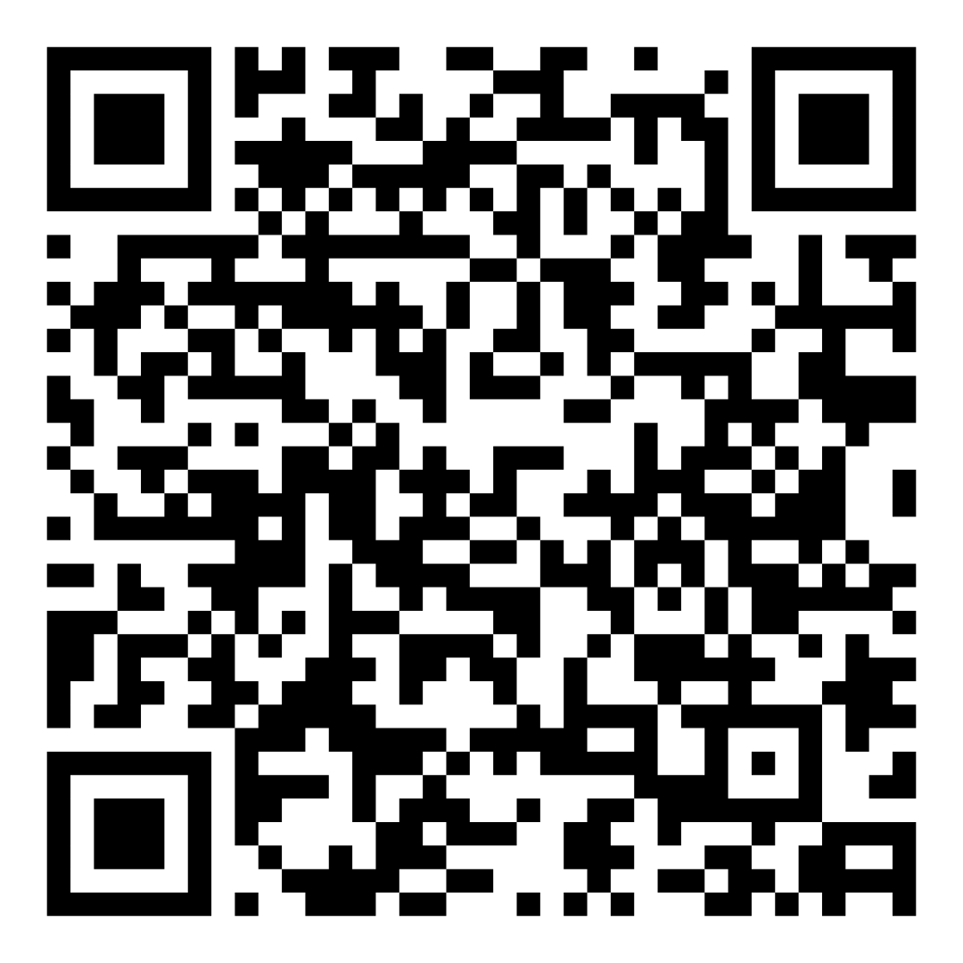

Access the Guideline
www.hivguidelines.org > Selecting an Initial ART Regimen
Also available: Printable pocket guide and PDF
Podcast: Viremic—Cases in HIV
Find all episodes at viremic.org

