Slide 1
Prevention and Treatment of Mpox
www.hivguidelines.org

Slide 2
Terminology
In November 2022, the CDC aligned its terminology with that of the WHO and adopted the term mpox to refer to monkeypox, to reduce negative effects, including stigma, associated with the use of the term monkeypox. Mpox refers to the disease caused by infection with the human monkeypox virus (MPXV), a member of the Orthopoxvirus genus related to the smallpox virus, but the use of the 2 terms and associated abbreviations is not standardized. The NYSDOH AI guideline uses the term mpox to refer to the virus and the associated disease.

Slide 3
Purpose of This Guideline
Increase clinicians’ awareness of and ability to recognize the common clinical manifestations of mpox and diagnose the disease in their patients.
Provide clinicians with evidence-based recommendations on primary prevention, diagnostic testing, and supportive care and treatment of mpox.
Increase clinicians’ awareness of recommended precautions to reduce occupational exposure to and community transmission of mpox.

Slide 4
Key Points: Clade I and Clade II Mpox
This guideline is intended to provide guidance for mpox prevention and treatment in general; however, because clade IIb dominated the 2022 worldwide outbreak, the majority of evidence supporting the clinical descriptions and recommendations pertain to clade II mpox.
For recommendations on testing if clade I mpox is suspected, such as in a patient who traveled to the Democratic Republic of Congo within 21 days, care providers in New York City can call the Provider Access Line at 1-866-692-3641; care providers in other counties in New York State can call the Office of Sexual Health and Epidemiology at 1-518-474-3598 during business hours or 1-866-881-2809 during evenings, weekends, and holidays.

Slide 5
Mpox Clinical Presentation
Mpox is characterized by a skin rash that can be macular, papular, vesicular, or pustular. Lesions in different stages may be present simultaneously.
Skin rash may or may not be accompanied by a systemic prodrome of fever, malaise, headache, myalgias, and lymphadenopathy.
Mucosal involvement, especially proctitis or pharyngitis, is common.
Coinfection with STIs is common.
Immunocompromised individuals, including those with advanced HIV, are more likely to develop severe manifestations.

Slide 6
Mpox Transmission Prevention and Infection Control for Healthcare Providers
Use of personal protective equipment, including a gown, gloves, eyewear, and an N-95 or comparable respirator mask, will help prevent occupational exposure in healthcare providers who are evaluating or collecting a specimen from a patient with suspected mpox. There is no need to unroof lesions before swabbing, and this practice may increase the risk of needlestick injury and occupational infection.

Slide 7
Mpox Transmission Prevention and Infection Control for Patients
Although, ideally, patients with mpox will isolate at home and remain separate from other people, this may not always be feasible. To reduce the risk of community transmission, advise patients with confirmed or suspected mpox to do the following until all lesions have healed and other symptoms have resolved:
Avoid skin-to-skin and sexual contact
Avoid sharing clothing, bed linens, and other soft, porous materials that may have come into contact with a lesion
Avoid sharing eating or personal hygiene utensils, such as razors; if items must be shared, wash and disinfect after each use
Avoid exposing other people to lesions (if an individual with mpox lesions must be in shared or public spaces, covering all lesions with clothing, bandages, or gloves can prevent transmission)
Wear a medical mask if in close proximity with other people for more than a brief encounter

Slide 8
Recommendations: Mpox Prevention
Clinicians should recommend the MVA (JYNNEOS) 2-dose vaccine series to individuals aged ≥18 years who are at risk of acquiring mpox. (A2)
Clinicians should recommend the MVA 2-dose vaccine series to individuals between ages 6 months and 18 years who are at risk of acquiring mpox. (A3) In August 2022, the FDA issued an EUA for emergency use of the JYNNEOS vaccine in individuals aged <18 years.
Clinicians should encourage individuals being vaccinated with MVA to receive both doses in the series for optimal protection. (A2)
Clinicians should not offer vaccination to individuals with prior laboratory-confirmed mpox. (A3)
Clinicians should recommend the MVA vaccine as PEP to individuals who have been exposed to mpox within the past 14 days and for whom vaccination may reduce the risk of infection or decrease symptoms if infection has occurred. (A2)
Clinicians should vaccinate individuals with HIV who are at risk of acquiring mpox regardless of CD4 count or viral load. (A2)

Slide 9
CDC Recommendations for Mpox Vaccination
Mpox vaccination should be offered to:
People who had known or suspected exposure to someone with mpox
People who had a sex partner in the past 2 weeks who was diagnosed with mpox
Gay, bisexual, and other men who have sex with men, and transgender or nonbinary people (including adolescents who fall into any of these categories) who, in the past 6 months, have had:
  A new diagnosis of 1 or more STIs (e.g., chlamydia, gonorrhea, syphilis)
  More than 1 sex partner
People who have had any of the following in the past 6 months:
  Sex at a commercial sex venue
  Sex in association with a large public event in a geographic area where mpox transmission is occurring
  Sex in exchange for money or other items
People who are sex partners of people with the above risks
People who anticipate experiencing any of the above scenarios
People with HIV or other causes of immunosuppression who have had recent or anticipate potential mpox exposure
People who work with orthopoxviruses in a laboratory

Slide 10
Recommendations:
Mpox Presentation and Diagnosis
Before evaluating people with suspected mpox, clinicians should don personal protective equipment, including a gown, an N95 respirator or comparable mask, eye protection, and gloves. (A3)
To diagnose mpox, clinicians should obtain 4 swabs for PCR testing: 2 specimens each taken from swabs of 2 skin lesions, whenever possible, preferably in different stages and at different body sites, without unroofing lesions. (A3)
Clinicians should recommend HIV antibody/antigen testing and STI testing (e.g., syphilis serologies and exposure-site gonorrhea and chlamydia NAAT) for any patient with suspected or confirmed sexually acquired mpox. (A3)
  See the NYSDOH AI guideline HIV Testing.
Clinicians should recommend that patients with suspected or confirmed mpox avoid exposing others to lesions to reduce mpox transmission. (A*)

Slide 11
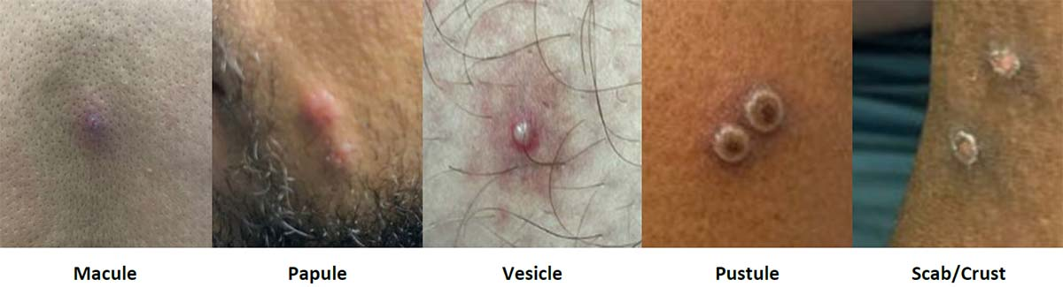
Stages of Mpox Lesions
Notes:
Photographs collected by the authors with patient consent.
See also Centers for Disease Control and Prevention Mpox > Clinical Features of Mpox.

Slide 12
Key Points: Mpox Presentation and Diagnosis
Test for mpox in patients who present with a rash that is potentially consistent with mpox, especially if epidemiologic criteria are present or a known exposure has occurred, regardless of vaccination status or prior infection.
Per New York State Public Health Law, all positive mpox test results must be reported to the local health department.

Slide 13
Common Differential Diagnoses for Clinical Syndromes Caused by Mpox
Clinical Syndrome | Common Differential Diagnoses and Distinguishing Features
Rash, localized or general | Herpes simplex virus: History of prior outbreaks is common; generalized rash is less common; systemic symptoms are uncommon with localized rash Varicella zoster virus: Dermatomal distribution (shingles); isolated anogenital involvement is less common Molluscum contagiosum: Lesions are typically painless; systemic symptoms, mucosal involvement, and lesions on palms or soles are less common Secondary syphilis: Rash typically presents without vesicles or umbilication, though can be ulcerated or pustular Acute HIV: Umbilication of skin lesions and anogenital involvement are uncommon
Genital ulcer | Herpes simplex virus: History of prior outbreaks is common; systemic symptoms are rare Primary syphilis: Typically painless Lymphogranuloma venereum: Ulcer is typically painless and often resolved at time of presentation Chancroid: Currently rare in the United States
Proctitis | Gonorrhea: No papular or vesicular lesions; no systemic symptoms Chlamydia (serovars D-K): No papular or vesicular lesions; no systemic symptoms Lymphogranuloma venereum: Genital ulcer is typically not concurrent with proctitis Secondary syphilis: Can present with a rectal mass, but genital ulcers are generally not concurrent Herpes simplex virus: History of prior outbreaks is common Enteric bacteria: No ulcers; no skin or mucosal lesions

Slide 14
Recommendation: Mpox Treatment
Clinicians should not use tecovirimat as monotherapy for the treatment of mpox. (A1)

Slide 15
Supportive Care Measures for Mpox Complications
Proctitis | Pharyngitis | Genital lesions
Stool softeners Sitz baths Lidocaine gel Nonsteroidal anti-inflammatory medications Gabapentin Opioids (if indicated) | Saltwater gargles Viscous lidocaine Magic mouthwash Oral antiseptics Nonsteroidal anti-inflammatory medications Opioids (if indicated) | Frequent bathing Keep lesions clean and dry If infected: Wet-to-dry dressings, systemic antibiotics

Slide 16
Medical Countermeasures for Mpox
Tecovirimat: At this time, clinicians should not use tecovirimat as monotherapy for mpox. Use of tecovirimat as part of combination therapy with another antiviral agent can be considered for individuals with advanced immunocompromise but should only be pursued in consultation with local/state departments of health or the CDC. For use in combination with brincidofovir, tecovirimat must be accessed via the CDC EA-IND protocol. Clinicians seeking expert consultation from the CDC in such cases can email poxvirus@cdc.gov.
Cidofovir and brincidofovir: Cidofovir is FDA-approved for IV treatment of CMV retinitis. Animal studies suggest cidofovir might be effective against orthopoxviruses, but there are no human data yet to confirm its effectiveness in treating mpox. Because of the risk of cidofovir-associated kidney damage, its IV form is typically reserved for severe mpox. Brincidofovir is thought to be less harmful to the kidneys but may lead to adverse effects. It is approved for treatment of smallpox via the animal rule but currently lacks clinical trial data for treatment of mpox in humans. Brincidofovir is available for mpox treatment through an EA-IND.
Vaccinia immune globulin intravenous (VIGIV): Can be particularly advantageous for individuals with compromised immune systems, such as those with advanced HIV, who may be unable to produce an adequate antibody response to infection.
Use of cidofovir, brincidofovir, and vaccine immunoglobulins has been limited to patients with severe disease and should occur only in consultation with an experienced specialist or the CDC Clinical Consultation Team, poxvirus@CDC.gov.
Trifluridine: Has in vitro activity against orthopoxviruses and is FDA-approved for treatment of eye infections caused by herpes simplex virus. Can be offered to patients with mpox ocular disease.

Slide 17

Need Help?

Slide 18

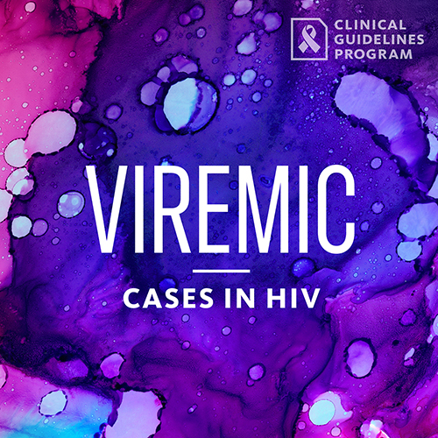
Access the Guideline
www.hivguidelines.org > Prevention and Treatment of Mpox
Also available: Printable pocket guide and PDF
Podcast: Viremic—Cases in HIV
Find all episodes at viremic.org

