Slide 1
Immunizations for Adults With HIV
www.hivguidelines.org

Slide 2
Purpose of This Guideline
Present a single compilation of all routine vaccinations for adults with HIV recommended by the Centers for Disease Control and Prevention (CDC), National Institutes of Health (NIH), HIV Medicine Association (HIVMA), and the Infectious Disease Society of America.

Slide 3
Recommendation: Immunizations
Clinicians should follow the recommendations for routine vaccination of adults with HIV issued by the Centers for Disease Control and Prevention, the National Institutes of Health, the HIV Medicine Association, and the Infectious Disease Society of America as presented here. (A3)

Slide 4
Key Points: Use of Live, Attenuated Vaccines
Individuals with CD4 count <200 cells/mm³: The following live, attenuated vaccines are contraindicated: Bacillus Calmette-Guérin; measles, mumps, rubella; oral typhoid; rotavirus; varicella; yellow fever; zoster.
Individuals with CD4 count ≥200 cells/mm³: Use live, attenuated vaccines only if an inactivated alternative is not available and the risk of disease is greater than the risk of vaccination.
Patient education: Patients with HIV should avoid handling diapers of infants vaccinated against rotavirus in the previous 4 weeks, and all household members should wash their hands after changing diapers of an infant recently vaccinated against rotavirus. Those who lack varicella immunity should avoid direct contact with people who develop rash.

Slide 5
COVID-19
COVID-19 Vaccines | Header
Trade Names See FDA Vaccines Licensed for Use in the United States | Moderna COVID-19 Vaccine (mRNA vaccine) Pfizer-BioNTech COVID-19 Vaccine (mRNA vaccine) Novavax COVID-19 Vaccine, Adjuvanted (protein subunit vaccine)
Indications | At least 1 monovalent 2024–2025 COVID-19 vaccine for all individuals aged 18 years and older with HIV Clinical Guidelines Program recommendation: Clinicians should vaccinate individuals with HIV and CD4 counts <350 cells/mm³ for COVID-19 according to the CDC schedule for individuals who are moderately or severely compromised. (A2)
Administration | Administer according to Tables 1 and 2 in CDC Interim Clinical Considerations for Use of COVID-19 Vaccines in the United States.
Comments | See also CDC Interim Clinical Considerations for Use of COVID-19 Vaccines in the United States > Description of moderate and severe immunocompromising conditions and treatments.

Slide 6
Key Points: COVID-19
Medical mistrust may prevent people in high vaccine priority groups from seeking or agreeing to vaccination; heightened awareness and open discussion of medical mistrust are essential to encouraging vaccination of people with HIV.
The effects of systemic racism and associated health inequities made apparent by the U.S. COVID-19 pandemic may create barriers to vaccine access among some people with HIV. Clinicians who provide medical care for people with HIV are strongly encouraged to discuss and advocate for vaccination with all of their patients.

Slide 7
Haemophilus influenzae Type B (Hib)
Haemophilus influenzae Type B Vaccine | Header
Trade Names | Hiberix ActHIB
Indications | Patients at risk of Hib infection
Administration | Administer according to CDC Adult Immunization Schedule.
Revaccination | None
Comments | Not routinely recommended for people with HIV in the absence of other risk factors

Slide 8
Hepatitis A Virus (HAV)
Hepatitis A Virus Vaccine | Header
Trade Names | HAV: Havrix; Vaqta HAV inactivated + HBV: Twinrix
Indications | All adults with HIV
Administration | Administer according to CDC Adult Immunization Schedule. Notes: Obtain HAV IgG testing ≥1 month after final dose of vaccination series to confirm immune response. If immune reconstitution appears likely, consider deferring until patient’s CD4 count ≥200 cells/mm³
Revaccination | Patients who do not respond to the primary HAV vaccination series should be revaccinated and counseled to avoid exposure.
Comments | See NYSDOH AI guideline Prevention and Management of Hepatitis A Virus Infection in Adults With HIV. Covered by HRSA Vaccine Injury Compensation Program

Slide 9
Hepatitis B Virus (HBV)
Hepatitis B Virus Vaccine | Header
Trade Names | HBV 2-dose series: HEPLISAV-B (see comments) HBV 3-dose series: Engerix-B; Recombivax HB; PreHevbrio (see comments) HAV inactivated + HBV 3-dose series: Twinrix
Indications | Patients who are negative for anti-HBs and do not have chronic HBV infection
Administration | Administer according to CDC Adult Immunization Schedule. Notes: Alternative administration strategies, such as a 3- or 4-injection double-dose vaccination series or an accelerated schedule of 0, 1, and 3 weeks, may be considered. Test for anti-HBs 4 to 16 weeks after administration of the last dose of the vaccination series.
Revaccination | Patients who do not respond to the primary HBV vaccination series (anti-HBs <10 IU/L) should be revaccinated with Heplisav-B or a double dose of the vaccine series previously administered.
Comments | PreHevbrio, a 3-antigen recombinant HBV vaccine, was approved in 2021 by the FDA for use for individuals ≥18 years old, but as of November 2024 is no longer available. See FDA PREHEVBRIO. In patients at risk for HBV infection, initial vaccination should not be deferred if the CD4 count is <200 cells/mm³. If an accelerated schedule is used, a fourth booster dose should be administered ≥6 months after initiation of the series; the accelerated schedule is not recommended for patients with CD4 counts ­<500 cells/mm³. The HAV/HBV combined vaccine is not recommended for the double-dose or 4-injection HBV vaccination strategy. Heplisav-B is not recommended in pregnancy because of lack of safety data. See NYSDOH AI guideline Prevention and Management of Hepatitis B Virus Infection in Adults With HIV. Covered by HRSA Vaccine Injury Compensation Program

Slide 10
Human Papillomavirus (HPV)
Human Papillomavirus Vaccine | Header
Trade Name | Gardasil 9
Indications | All patients 9 to 45 years old who were not previously vaccinated or did not receive a complete 3-dose series
Administration | Administer through age 45 years as a 3-dose series according to CDC Adult Immunization Schedule
Revaccination | None
Comments | A 2-dose schedule is not recommended. Because of the broader coverage offered by the 9-valent HPV vaccine, it is the only HPV vaccine currently available in the United States. Although the 9-valent vaccine has not been specifically studied in people with HIV, it is expected that the response will be the same in this population as with the quadrivalent vaccine. Follow recommendations for cervical and anal cancer screening in NYSDOH AI guidelines Screening for Cervical Dysplasia and Cancer in Adults With HIV and Screening for Anal Dysplasia and Cancer in Adults With HIV. Covered by HRSA Vaccine Injury Compensation Program

Slide 11
Influenza
Influenza Vaccine | Header
Trade Names | See Table 1 in CDC Prevention and Control of Seasonal Influenza with Vaccines: Recommendations of the Advisory Committee on Immunization Practices — United States, 2025–26 Influenza Season
Indications | All adults with HIV
Administration | Administer annually during flu season (October through May) according to CDC Adult Immunization Schedule
Revaccination | None
Comments | Covered by HRSA Vaccine Injury Compensation Program

Slide 12
Measles, Mumps, Rubella (MMR)
Measles, Mumps, Rubella Vaccine | Header
Trade Names | M-M-R II
Indications | For patients with CD4 counts ≥200 cells/mm³ for ≥6 months who do not have evidence of MMR immunity
Administration | Administer according to the CDC Adult Immunization Schedule
Revaccination | Recommended only in the setting of an outbreak
Comments | Contraindicated for patients with CD4 counts <200 cells/mm³ The MMR + varicella vaccine (ProQuad) should not be substituted for the MMR vaccine. Those who previously received 2 doses of a mumps-containing vaccine and are at increased risk for mumps in the setting of an outbreak should receive a third dose to improve protection against mumps disease and related complications. Covered by HRSA Vaccine Injury Compensation Program

Slide 13
Meningococcal Serotypes A,C, W, and Y (MenACWY)
Meningococcal Serotypes A,C, W, and Y Vaccine | Header
Trade Names | Menactra (MenACWY-D) Menveo (MenACWY-CRM) MenQuadfi (MenACWY-TT)
Indications | All patients with HIV
Administration | Administer 2 doses of MenACWY vaccine ≥8 weeks apart in those not previously vaccinated. For those previously vaccinated with 1 dose of MenACWY vaccine, administer the second dose at the earliest opportunity ≥8 weeks after the previous dose. See CDC Adult Immunization Schedule
Revaccination | Administer 1 booster dose of MenACWY vaccine every 5 years.
Comments | MenACWY-D should not be administered until ≥4 weeks after pneumococcal conjugate vaccine. See Meningococcal Disease: NYSDOH Health Advisory and Vaccine Recommendations Covered by HRSA Vaccine Injury Compensation Program

Slide 14
Meningococcal Serotype B (MenB)
MenB Vaccine for Prevention of MenB Infection | Header
Trade Names | Bexsero (4CMenB) Trumenba (MenB-FHbp)
Indications | Patients at risk of MenB infection
Administration | Administer according to CDC Adult Immunization Schedule
Revaccination | None
Comments | Bexsero (4CMenB) and Trumenba (MenB-FHbp) are not interchangeable. Not routinely recommended for people with HIV in the absence of other risk factors Covered by HRSA Vaccine Injury Compensation Program

Slide 15
Recommendations: Mpox Vaccine
Clinicians should recommend vaccination against mpox (formerly “monkeypox”) for individuals ≥18 years old with HIV who are at high risk of or who have been exposed to mpox within the past 14 days and for whom vaccination may reduce the risk of infection or decrease symptoms if infection has occurred. (A2)
Clinicians should use only the JYNNEOS (Imvamune or Imvanex) mpox vaccine for individuals with HIV, as it is the only available vaccine that is considered safe for administration in this population. (A*)
Clinicians should recommend vaccination for adults with HIV, regardless of their CD4 cell count and degree of viral suppression. (A3)

Slide 16
Mpox
Mpox Vaccine | Header
Trade Name | JYNNEOS (also called Imvamune or Imvanex)
Type of Vaccine | Live virus that does not replicate efficiently in human cells
Administration | Two subcutaneous injections 4 weeks apart
Indication | Individuals with HIV ≥18 years old who are at high risk of or who have been exposed to mpox within the past 14 days
Adverse Reactions | Injection site reactions such as pain, swelling, and redness. Vaccination with JYNNEOS will not cause mpox infection.
Contraindications | Severe allergy to any component of the vaccine (gentamicin, ciprofloxacin, or egg protein)
Immune Response | Maximal development of the immune response takes 2 weeks after second dose.
Pregnancy/ Breastfeeding | No evidence of reproductive harm from animal data. Pregnancy and breastfeeding are not contraindications for vaccination.

Slide 17
Key Points: Mpox
JYNNEOS (Imvamune or Imvanex) is the only mpox vaccination safe for adults with HIV.
Care should be taken to avoid language and behavior that marginalizes and stigmatizes communities at risk.

Slide 18
Pneumococcal
Pneumococcal Vaccine | Header
Trade Names | Vaxneuvance (PCV15; 15-valent pneumococcal conjugate vaccine) Prevnar 20 (PCV20; 20-valent pneumococcal conjugate vaccine) Pneumovax 23 (PPSV23; 23-valent pneumococcal polysaccharide vaccine)
Indications | All patients with HIV
Administration | For patients who have not received a pneumococcal vaccine or whose vaccination status is unknown: Vaccinate with 1 dose of PCV15 or 1 dose of PCV20. If PCV15 is used, follow with 1 dose of PPSV23, with a minimum interval of 8 weeks between the doses.
Revaccination | Consult CDC PneumoRecs VaxAdvisor
Comments | Pneumococcal vaccination should be not be deferred for patients with CD4 count <200 cells/mm³ and/or detectable viral load; however, the follow-up secondary administration of the PPSV23 vaccine may be deferred until the patient’s CD4 count is ≥200 cells/mm³ and/or viral load is undetectable. The Menactra (MenACWY-D) vaccine for meningococcal serotype groups A,C, W, and Y (MenACWY) should not be administered until ≥4 weeks after pneumococcal conjugate vaccine.

Slide 19
Tetanus, Diphtheria, and Pertussis (Tdap) and Tetanus-Diphtheria (Td)
Tetanus, Diphtheria, and Pertussis and Tetanus-Diphtheria Vaccines | Header
Trade Names | Tdap: Adacel; Boostrix Td: Tenivac; TDVax
Indications | All adult patients
Administration | Administer according to CDC Adult Immunization Schedule
Revaccination | Td is usually given as a booster dose every 10 years, but it can also be given earlier after a severe and dirty wound or burn.
Comments | Covered by HRSA Vaccine Injury Compensation Program

Slide 20
Varicella
Varicella Vaccine | Header
Trade Names | Varivax
Indications | For patients with CD4 counts ≥200 cells/mm³ who do not have evidence of immunity to varicella
Administration | Administer according to CDC Adult Immunization Schedule
Revaccination | None
Comments | Contraindicated for patients with CD4 counts <200 cells/mm³ Anti-varicella IgG screening should be performed in patients with no known history of chickenpox or shingles. MMR + varicella (ProQuad) vaccine should not be used. Antiherpetic agents should be avoided ≥24 hours before and for 14 days after administration. An interval of ≥5 months is recommended between administration of post-exposure VariZIG and varicella vaccination. Clinical disease due to varicella after vaccination, a very rare event, should be treated with acyclovir. Covered by HRSA Vaccine Injury Compensation Program

Slide 21
Zoster
Zoster Vaccine | Header
Trade Names | Shingrix: RZV, adjuvanted
Indications | MCCC recommendation: Patients with HIV ≥18 years old (A2)
Administration | Two intramuscular doses, given 2 to 6 months apart, regardless of past receipt of ZVL (brand name Zostavax) Perform anti-varicella IgG screening in patients with no known history of chickenpox or shingles. See CDC Adult Immunization Schedule
Comments | RZV provides strong protection against shingles and post-herpetic neuralgia. Currently, there are no data on immunogenicity specific to people with HIV; however, superior efficacy and longer duration of protection have been demonstrated among the elderly, and a recombinant vaccine is preferred for people with HIV. As of November 2020, ZVL is no longer available for use in the United States.

Slide 22

Need Help?

Slide 23
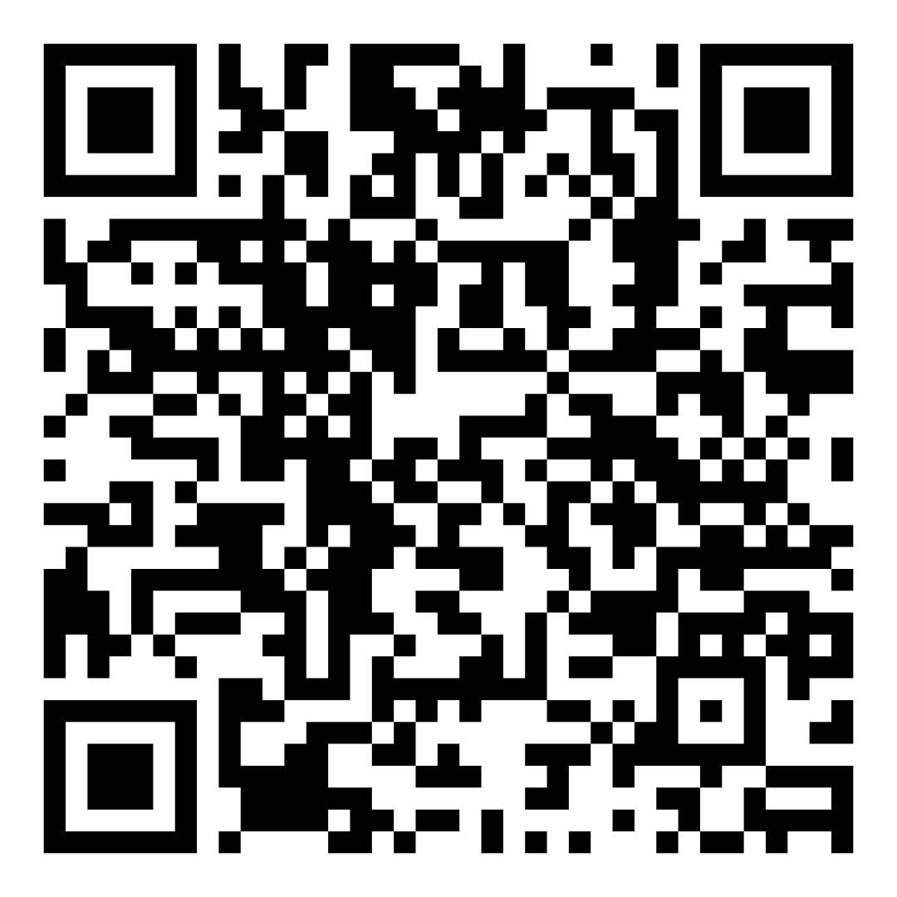
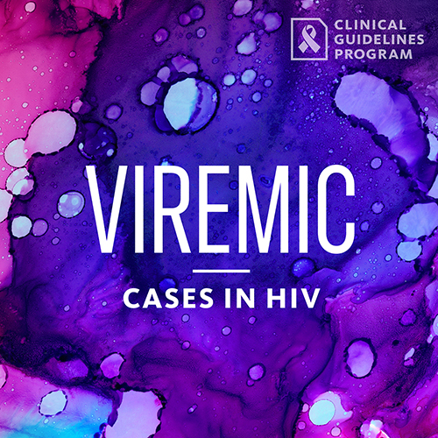
Access the Guideline
www.hivguidelines.org > Immunizations for Adults With HIV
Also available: Printable PDF
Podcast: Viremic—Cases in HIV
Find all episodes at viremic.org

