Slide 1
Prevention and Management of Hepatitis B Virus Infection in Adults With HIV
www.hivguidelines.org

Slide 2
Purpose of This Guideline
Raise awareness among clinicians about the prevalence and associated risks of chronic HBV in patients with HIV.
Increase screening for and vaccination against HBV in adults with HIV.
Provide up-to-date, evidence-based recommendations on diagnosis, assessment, treatment, and monitoring of chronic HBV infection in patients with HIV, with emphasis on the essential components of antiretroviral therapy to treat coinfection.

Slide 3
New York State Law: Reporting HBV Infection
Clinicians must report all suspected or confirmed HBV infections, and specify acute or chronic, to the local health department of the area where the individual resides according to NYSDOH Communicable Diseases Reporting Requirements.

Slide 4
Recommendations: Screening Tests
Clinicians should determine the HBV vaccination and immune status of patients with HIV by performing laboratory testing for HBsAg, anti-HBs, and anti-HBc (total). (A*) See Interpretation of HBV Screening Test Results.
Clinicians should repeat laboratory screening annually in patients who are not immune to HBV, choose not to be vaccinated, and are at ongoing risk of acquiring HBV. (A3)

Slide 5
Interpretation of HBV Screening Test Results
HBsAg | Anti-HBs | Anti-HBc | Header | Interpretation
 |  | IgG | IgM
Negative | Negative | Negative | Negative | Susceptible to HBV infection
Negative | Positive | Negative | Negative | Immune due to HBV vaccination
Negative | Positive | Positive | Negative | Immune due to natural HBV infection
Positive | Negative | Positive | Positive | Acute HBV infection
Positive | Negative | Positive | Negative/ Positive | Chronic HBV infection
Positive | Negative | Positive | Negative/ Positive | Isolated anti-HBc positivity. Possible interpretations: Resolved HBV infection with waning anti-HBs titers False-positive result Occult HBV infection Resolving acute HBV infection

Slide 6
Recommendations: Diagnosis
In patients with positive baseline (screening) HBsAg test results, clinicians should perform HBeAg, anti-HBe, and HBV DNA testing to diagnose the phase of HBV infection. (B2†) See Serologic and Virologic Responses to HBV Infection.
If a patient with HIV and unknown HBsAg status has signs or symptoms of acute hepatitis (i.e., elevated ALT), the clinician should perform HBsAg, anti-HBc IgM, HBeAg, anti-HBe (A*), and HBV DNA (A3) testing along with other diagnostic testing for acute hepatitis.

Slide 7
Serologic and Virologic Responses to HBV Infection
Stage of Infection | HBsAg | Anti-HBs | Anti-HBc IgG | Anti-HBc IgM | HBeAg | Anti-HBe | HBV DNA Level
Incubation | + | − | − | − | + or − | − | Low
Acute HBV infection | + | − | + | + | + | − | High
HBs-negative acute HBV | − | − | + | + | + or − | − | High
Inactive HBsAg carrier | + | − | +++ | + or − | − | + | Low
Precore mutant | + | − | + or − | + or − | − | + | High
Occult infection | − | − | + | + or − | − | − | High or low
Chronic HBV infection | + | − | +++ | + or − | + or − | − | High or low

Slide 8
Recommendations: Acute HBV Infection
If acute HBV infection is confirmed and the patient is asymptomatic, the clinician should repeat ALT testing within 2 to 4 weeks to assess for symptoms of liver disease progression (B3) and repeat HBsAg, HBeAg, anti-HBe, and HBV DNA testing 6 months later to determine whether infection has cleared. (A3)
If a patient with HIV and acute HBV is not taking ART, the clinician should recommend ART initiation. (A1)

Slide 9
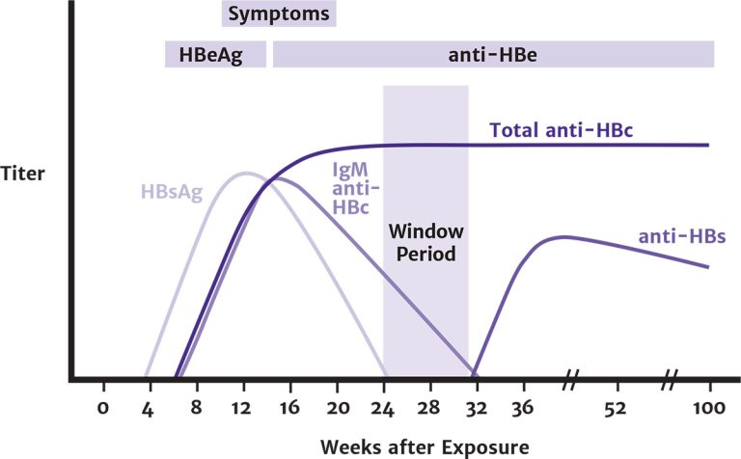
Typical Serologic Course of Acute Hepatitis B Virus Infection With Recovery
Reprinted from CDC Recommendations for Identification and Public Health Management of Persons with Chronic Hepatitis B Virus Infection

Slide 10
Recommendations: Transmission Prevention
Clinicians should advise patients who have a positive HBsAg test result that they can transmit HBV (A*) and encourage sexually active patients to use effective barrier protection to reduce the risk of HBV transmission. (A2†)
Clinicians should inform patients with HBV that their household contacts should be vaccinated and counsel the patients to avoid sharing items such as razors or toothbrushes that could expose others to HBV-contaminated blood. (A2†)
For individuals who inject drugs, clinicians should offer or refer for substance use treatment, ensure access to clean needles and syringes, and provide harm reduction counseling. (A2†)

Slide 11
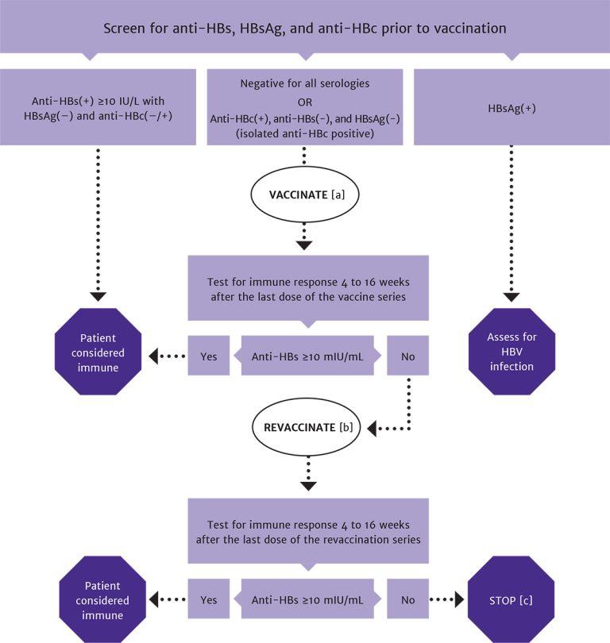
Algorithm for HBV Screening and Vaccination in Patients With HIV
In patients with positive anti-HBc, negative anti-HBs, and negative HBsAg test results, vaccinate with 1 standard dose of HBV vaccine and check anti-HBs titer after 8 weeks. If titer is <100 mlU/mL, complete remaining doses in the vaccine series and recheck titer 8 weeks after the last vaccine.
In patients with anti-HBs levels <10 mlU/mL (vaccine nonresponse), revaccination is recommended with the Heplisav-B vaccine series or a double dose of the vaccine series previously administered.
A patient who is negative for all serologies and who does not respond to revaccination may have a primary nonresponse or chronic infection. HBV DNA testing may be used to detect the presence of chronic HBV infection.

Slide 12
Recommendations: Primary Vaccination
Clinicians should offer HBV vaccination with the 3-dose Engerix-B or Recombivax HB vaccine series (A1) or the 2-dose Heplisav-B vaccine series (A2†) to patients with negative test results for HBsAg, anti-HBs, and anti-HBc.
Clinicians should not defer initial HBV vaccination in patients with a CD4 count <200 cells/mm³ who are at risk for HBV infection. (A2)
Clinicians should repeat anti-HBs testing 4 to 16 weeks, based on the patient’s visit schedule, after completion of the vaccination series to ensure immunity (anti-HBs ≥10 mIU/mL). (A3)
In a patient with negative HBsAg, negative anti-HBs, and positive anti-HBc test results (isolated anti-HBc positive), the clinician should offer a 1-time dose of HBV vaccine. (A2)
Repeat anti-HBs testing 8 weeks after vaccination, and if the anti-HBs titer is <100 mIU/mL, complete the HBV vaccine series and repeat anti-HBs testing 8 weeks after the last vaccine. (A2)
If vaccination is refused or if follow-up anti-HBs titer testing cannot be assured, perform HBV DNA testing to evaluate for occult HBV infection. (A2)
Clinicians should not defer initial vaccination or revaccination in pregnant patients with HIV who do not have immunity to HBV. (A3)

Slide 13
HBV Vaccine Dosing Schedule
Vaccine | Dosing | Notes
Engerix-B | Single dose: 20 µg as one 1 mL dose containing 20 µg/mL vaccine administered as follows: 3 IM injections at weeks 0, 4, and 24 OR 4 IM injections at weeks 0, 4, 8, and 24 Double dose: 40 µg as two 1 mL doses of 20 µg/mL vaccine administered as follows: 3 IM injections at weeks 0, 4, and 24 OR 4 IM injections at weeks 0, 4, 8, and 24 | Patients with ESRD or other immunocompromising conditions: 40 µg/mL as two 1 mL doses of 20 µg/mL vaccine administered in 3 IM injections at weeks 0, 4, 8, and 24
Recombivax HB | Single dose: 10 µg as one 1 mL dose containing 10 µg/mL vaccine administered as follows: 3 IM injections at weeks 0, 4, and 24 OR 4 IM injections at weeks 0, 4, 8, and 24 Double dose: 20 µg as two 1 mL doses containing 10 µg/mL vaccine administered as follows: 3 IM injections at weeks 0, 4, and 24 OR 4 IM injections at weeks 0, 4, 8, and 24 | Patients with ESRD or other immunocompromising conditions: 40 µg/mL as 1 mL of higher-strength vaccine administered in 4 IM injections at weeks 0, 4, and 24

Slide 14
HBV Vaccine Dosing Schedule, continued
Vaccine | Dosing | Notes
Heplisav-B | Single dose: 20 µg as one 0.5 mL dose containing 20 µg/mL vaccine administered as follows: 2 IM injections at weeks 0 and 4 | Patients with ESRD: Standard dosing Pregnant patients: Insufficient data to recommend use
Twinrix | Single dose: 1 mL administered as follows: 3 IM injections at weeks 0, 4, and 24 | For patients who are not immune to either HBV or HAV

Slide 15
Key Point: Follow-up Testing
Patient education regarding HBV vaccination is important to ensure awareness of the continued risk of acquiring and subsequently transmitting HBV until adequate anti-HBs response is confirmed.

Slide 16
Recommendation: Revaccination
In previously vaccinated patients with anti-HBs levels <10 mIU/mL (vaccine nonresponse), clinicians should recommend revaccination with the Heplisav-B vaccine series or a double dose of the vaccine series previously administered. (A2)

Slide 17
Recommendations: Liver Disease Assessment
Before initiating HBV treatment in patients with HIV, clinicians should obtain a complete physical examination and medical history, including the use of hepatoxic medications (A*); noninvasive fibrosis evaluation (A2†); baseline ultrasonography for HCC (A2†); and the following laboratory testing: CBC, albumin, bilirubin, alkaline phosphatase, PT/INR, ALT, AST, and a basic metabolic panel. (A*)
Clinicians should refer patients with HIV/HBV coinfection and cirrhosis to a gastroenterologist or hepatologist to assess and manage complications of portal hypertension. (A3)
In patients with HIV/HBV coinfection and cirrhosis, clinicians should screen for HCC with ultrasound every 6 months. (A2†) See full guideline regarding screening for patients without cirrhosis.

Slide 18
Recommendation: Alcohol Use Screening and Education
Clinicians should perform alcohol use screening in patients with HIV/HBV coinfection at baseline and at least annually and refer patients for treatment as needed. (A3)
Clinicians should educate patients about the detrimental effects of alcohol use on the course of HBV infection and counsel patients with underlying liver disease to abstain from or minimize alcohol use. (A*)

Slide 19
Recommendations: HAV, HCV, and HDV Status
Clinicians should perform anti-HAV IgG or total (IgM and IgG) serum testing and administer the full HAV vaccine series in patients who are not immune to HAV. (A3)
Clinicians should determine patients’ HCV status by medical history and serum testing and recommend treatment with DAA therapy if chronic HCV infection is diagnosed. (A1)
Clinicians should perform anti-HDV total (IgM and IgG) serum testing to screen for HDV in all patients with HIV/HBV coinfection. (B2)

Slide 20
Recommendations: Treatment
Clinicians should recommend immediate ART initiation for any patient with HIV/HBV coinfection who is not taking ART. (A1)
Preferred: In patients with HIV and chronic HBV, clinicians should recommend an ART regimen that includes 2 agents active against HBV (see Available Medications for Treatment of HBV Infection in Adults With HIV). Preferred regimens include a backbone of either TAF/FTC, TDF/FTC, or TDF/3TC. (A2)
Clinicians should not prescribe a 2-drug regimen of TAF/FTC, TDF/FTC, or TDF/3TC alone to treat patients with HIV/HBV coinfection; a fully suppressive ART regimen is required. (A1)
Nonadherence with or discontinuation of anti-HBV treatment may result in transaminase flares and hepatic damage. Clinicians should educate patients about the treatment adherence requirements (A*), and if treatment must be interrupted or discontinued, consult with a care provider experienced in HIV/HBV coinfection. (A3)
Alternative: If a patient cannot or chooses not to take TDF or TAF, the clinician should initiate treatment with ETV and a fully suppressive ART regimen for HIV. (A3)
Pregnant patients: Clinicians should offer pregnant patients treatment with an ART regimen that includes 2 agents active against both HIV and HBV; 3TC, FTC, TAF, and TDF can be used safely during pregnancy at standard doses. (A2†)

Slide 21
Available Medications for Treatment of HBV Infection in Adults With HIV
Medication | Clinical Comment
Tenofovir disoproxil fumarate (TDF) | A prodrug of the NRTI tenofovir active against HIV and HBV, including 3TC-resistant HBV A preferred agent for chronic HBV treatment because of its high virologic efficacy and low risk of HBV resistance Potential association with renal impairment and loss of bone density Initiate only in patients with CrCl ≥50 mL/min.
Tenofovir alafenamide (TAF) | A prodrug of the NRTI tenofovir active against HIV and HBV that achieves higher intracellular concentrations in peripheral blood mononuclear cells and hepatocytes than TDF Improved biomarkers for renal and bone safety compared with TDF while maintaining high rates of HIV and HBV viral suppression In HIV/HBV coinfection, switching from a TDF- to a TAF-containing regimen demonstrated similarly high levels of HBV virologic control. Initiate only in patients with CrCl ≥30 mL/min.
Lamivudine (3TC) | An HBV reverse transcriptase inhibitor and HIV NRTI active against HIV and HBV Has a low genetic barrier to HIV and HBV resistance and should not be used as the sole anti-HBV drug in an ART regimen. Studies found the rate of HBV resistance reached 90% after 4 years of 3TC monotherapy. Avoid 3TC monotherapy.

Slide 22
Available Medications for Treatment of HBV Infection in Adults With HIV, continued
Medication | Clinical Comment
Emtricitabine (FTC) | An NRTI similar to 3TC and active against HIV and HBV 3TC-resistant isolates are also cross-resistant to FTC. Do not use as the sole anti-HBV drug in an ART regimen.
Entecavir (ETV) | An NRTI active against HIV and HBV May select for 3TC- and FTC-resistant HIV ETV monotherapy for HBV is not recommended in patients with HIV unless combined with a fully active ART regimen to treat HIV.
Interferon (IFN) | IFN alfa-2a or -2b or PEG-IFN alfa-2a is used as HBV treatment in patients with HBV monoinfection. Contraindicated in patients with decompensated liver disease (Child-Turcotte-Pugh class B or C) PEG-IFN alfa-2a monotherapy for up to 48 weeks may be considered for HBV treatment in patients with HIV/HBV coinfection if concurrent ART active against HIV and HBV is not possible. PEG-IFN alfa-2a is not associated with HBV drug resistance.

Slide 23
Recommended Additions to 2-Drug HIV ART Regimens for Patients With Chronic HBV
Drug HIV ART Regimen | Addition for HBV Treatment
DTG/3TC | TAF, TDF, or ETV
DTG/RPV | TAF/FTC, TDF/FTC, or TDF/3TC
CAB/RPV | TAF/FTC, TDF/FTC, or TDF/3TC

Slide 24
Recommendations: Monitoring
After HBV treatment initiation, clinicians should perform the laboratory testing listed in Recommended Monitoring After HBV Treatment Initiation in Adults With HIV. (A3)
If a patient being treated for chronic HBV develops signs or symptoms of acute hepatitis (nausea, vomiting, elevated ALT or bilirubin levels), the clinician should rule out HBV IRIS and HDV flare and consult with an HIV-experienced hepatologist. (A3)

Slide 25
Recommended Monitoring After HBV Treatment Initiation in Adults With HIV
Laboratory Test | Every 3 Months | Every 6 Months | Every 12 Months
HBV DNA | Until HBV DNA is undetectable | After HBV DNA is undetectable
HBeAg |  |  | Check for HBeAg-negative result
Electrolyte panel |  | X
Serum creatinine |  | X
Urinalysis |  |  | X
Liver function panel | Until HBV DNA is undetectable | After HBV DNA is undetectable

Slide 26
Need Help?

Slide 27
Access the Guideline
www.hivguidelines.org > Prevention and Management of Hepatitis B Virus Infection in Adults With HIV
Also available: Printable pocket guide and PDF

