Slide 1
Substance Use Screening and Risk Assessment in Adults
www.hivguidelines.org

Slide 2
Purpose of This Guideline
Increase the identification of unhealthy substance use among NYS residents and increase access to evidence-based interventions for appropriate patients. “Unhealthy substance use” refers to a spectrum of use that increases the risk of health consequences and ranges from hazardous or risky patterns of use to severe SUD.
Increase the number of clinicians in NYS who perform substance use screening and risk assessment as an integral part of primary care.
Provide clinicians with guidance on selecting validated substance use screening and risk assessment tools and on providing or referring for evidence-based interventions.
Promote a harm reduction approach to the identification and treatment of substance use and SUDs, which involves practical strategies and ideas aimed at reducing the negative consequences associated with substance use.

Slide 3
Key Point
It is essential that clinicians are aware of their own biases and try to set them aside when screening and evaluating patients for drug and alcohol use.

Slide 4
Unhealthy Substance Use
“Unhealthy substance use” refers to a spectrum of use that increases the risk of health consequences and ranges from hazardous or risky patterns of use to severe SUD.
As defined here, unhealthy alcohol use is use that exceeds guideline-recommended levels; for illicit drugs, any use is considered potentially unhealthy. For prescription medications with potential for misuse, any nonmedical use (use of prescribed medication at increased dose or frequency or for reasons other than prescribed) or use of medications that were not prescribed is considered unhealthy.
Brief screening tools can identify potentially unhealthy use and can be followed by a risk assessment to determine the clinical significance and severity of use.

Slide 5
Substance Use Levels of Risk
Low risk: Patient is abstinent or uses substances in a way that is not currently associated with negative health consequences or other problems (e.g., alcohol consumption that does not exceed guideline-recommended levels or occasional cannabis use).
Moderate risk: Patient is at risk for and may already be experiencing negative health consequences or other problems, such as elevated blood pressure related to alcohol use, atypical chest pain related to cocaine use, or family problems or poor work performance related to opioid use.
High risk: Patient likely has an SUD, is likely experiencing substance-related health or other types of problems (e.g., alcohol use–related cirrhosis or consequences such as separation from family or loss of employment), and is engaging in continued or escalating use despite negative consequences.

Slide 6
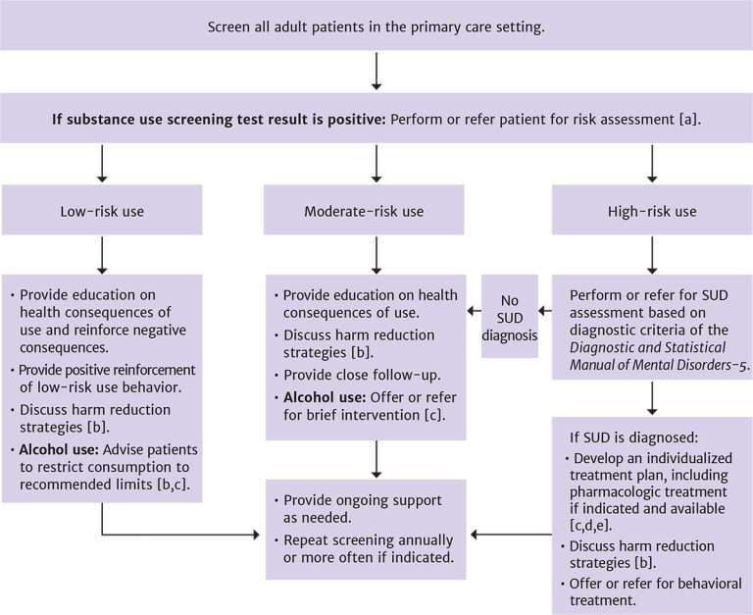
Substance Use Identification and Risk Assessment in Primary Care

Slide 7
Recommendations: Primary Care Screening for Adults
During the initial visit and during annual follow-up visits, primary care clinicians should screen for the following in adults ≥18 years old:
Alcohol use, and when unhealthy use is identified, assess the level of risk to the patient. (A1)
Tobacco use, and when it is identified, provide assessment and counseling. (A1)
Drug use (B3), and when unhealthy use is identified, assess the level of risk to the patient. (A3)
Before screening for drug use, clinicians should explain the risks and benefits of screening to all patients, especially those who are pregnant or planning to conceive; the discussion should include state reporting requirements and the potential for involvement of child protective services. (A3)
Clinicians should repeat substance use screening to inform clinical care when:
Prescribing medication(s) that have adverse interactions with alcohol or drugs. (A2)
A patient has symptoms or medical conditions that could be caused or exacerbated by substance use. (A3)

Slide 8
Key Points: Primary Care Screening for Adults
It is important to ask patients about substance use during an initial visit and during follow-up visits because patterns of use may change over time. Annual screening may be most appropriate, and most validated alcohol and drug screening questionnaires ask about use in the past year.
It is important to inform patients that information about their substance use is protected by the same privacy laws that apply to all other information in their medical records.
Urine toxicology, measures of blood alcohol level, and other laboratory tests should not be relied on for identifying unhealthy drug use.

Slide 9
Implementing Substance Use Screening in Primary Care Settings
Who to screen: All adults seen by primary care providers should be screened for substance use. Some specific patient populations may have higher rates of unhealthy substance use, but there are no specific demographic characteristics that reliably predict such use.
How often to screen: Because substance use behavior changes over time, care providers should repeat screening at regular intervals. However, evidence is lacking about the optimal frequency of screening. Annual screening may strike the best balance between the need for frequent repetition of screening and time and resource constraints and has been recommended by an expert panel.
Who should perform the screening: Most of the screening instruments discussed in Recommended Validated Tools for Use in Medical Settings to Screen for Alcohol and Drug Use in Adults can be administered verbally by trained staff or can be self-administered by patients on paper or on a computer. Primary care practices must choose the format that is most appropriate for their clinical workflow and patient population.
How to introduce substance use screening to patients: Explain the reasons for screening, the type of screening that will be performed, the potential benefits, and any potential harms. Make sure that patients understand how results will be interpreted and the likely response to screening results. Remind them of the privacy protections for the information being collected, including who will see the information; acknowledge the potential sensitivity of the information; and avoid judgmental or stigmatizing language.

Slide 10
Recommendation: Screening Tools
Healthcare providers should use standardized and validated questionnaires for substance use screening (see Recommended Validated Tools for Use in Medical Settings to Screen for Alcohol and Drug Use in Adults). (A3)
Key Point: Whenever possible, it is best to have patients self-administer the screening and assessment questionnaires rather than having the clinician or staff ask the questions. In general, self-administered screening facilitates more accurate reporting of stigmatized behavior, such as substance use.

Slide 11
Recommended Validated Tools for Use in Medical Settings to Screen for Alcohol and Drug Use in Adults
Tool | Substance(s) Included | No. of Items, Approximate Time Required to Complete, and Format
AUDIT-C (Alcohol Use Disorders Identification Test–Concise) Available in languages other than English | Alcohol | 3 items; 1 to 2 minutes Interviewer- or self-administered via electronic app or on paper
SISQ-Alc (Single-Item Screening Questions for Alcohol) | Alcohol | 1 item; 1 minute Interviewer- or self-administered via electronic app or on paper
SISQ-Drug (Single-Item Screening Questions for Drug Use) | Prescription drugs, other drugs | 1 item; 1 minute Interviewer- or self-administered via electronic app or on paper
SoDU (Screen of Drug Use) | Prescription drugs, other drugs | 2 items; 1 minute Interviewer
SUBS (Substance Use Brief Screen) | Tobacco, alcohol, prescription drugs, other drugs | 4 items; 2 minutes Interviewer- or self-administered via electronic app or on paper
TAPS-1 (Tobacco, Alcohol, Prescription Medication, and Other Substance Use) | Tobacco, alcohol, prescription drugs, other drugs | 4 items; 2 minutes Interviewer- or self-administered via electronic app

Slide 12
Recommendations: Risk Assessment
Clinicians should assess the level of substance use risk in individuals who have a positive substance use screening result or a history of SUD or overdose. (A3)
Clinicians should use standardized and validated tools to assess the level of risk associated with substance use (see Brief, Validated Risk Assessment Tools for Use in Medical Settings With Adults). (A3)

Slide 13
Brief, Validated Risk Assessment Tools for Use in Medical Settings With Adult ≥18 Years Old
Tool | Substance(s) Included | No. of Items, Approximate Time to Required to Complete, and Format
ASSIST (Alcohol, Smoking, and Substance Involvement Screening Test) Available in languages other than English | Tobacco, alcohol, prescription drugs, other drugs; identifies specific drug classes | 10 to 71 items; 5 to 15 minutes, depending on no. of substances used Interviewer administered
ACASI-ASSIST (Audio Computer-Assisted Self-Interview–ASSIST) | Tobacco, alcohol, prescription drugs, other drugs; identifies specific drug classes | 10 to 98 items; 5 to 15 minutes, depending on no. of substances used Self-administered on computer/tablet
AUDIT (Alcohol Use Disorders Identification Test) Available in languages other than English | Alcohol | 10 items; 3 minutes Interviewer- or self-administered

Slide 14
Brief, Validated Risk Assessment Tools for Use in Medical Settings With Adult ≥18 Years Old, continued
Tool | Substance(s) Included | No. of Items, Approximate Time to Required to Complete, and Format
DUDIT (Drug Disorders Identification Test) Available in languages other than English | All drugs; does not identify drug classes | 11 items; 5 minutes Interviewer- or self-administered on paper
DAST-10 (Drug Abuse Screening Test) Available in languages other than English | All drugs; does not identify drug classes | 10 items; 10 minutes or less Interviewer- or self-administered on paper
TAPS (Tobacco, Alcohol, Prescription Medication, and Other Substance Use) | Tobacco, alcohol, prescription drugs, other drugs; identifies specific drug classes | 4 to 25 items; 2 to 4 minutes, depending on no. of substances used Interviewer- or self-administered on computer/tablet

Slide 15
Brief Intervention: “Can We Spend a Few Minutes Talking About Your Substance Use?”

Slide 16
Recommendations: Diagnosis of Substance Use Disorder
For accurate diagnosis of a SUD and its severity, clinicians should perform or refer patients for a full assessment based on DSM-5 criteria. (A3)
Clinicians should assess patients’ perceptions of their substance use and readiness to change substance use behaviors. (A3)
If individuals present with symptoms consistent with both an SUD and a mental health disorder, clinicians should assess for both types of disorder before making a diagnosis and should refer for specialty behavioral healthcare when indicated. (A3)

Slide 17
DSM-5 Diagnostic Criteria for Diagnosing and Classifying Substance Use Disorders
Header | Header
Impaired control over substance use (DSM-5 criteria 1 to 4) | Consuming the substance in larger amounts and for a longer amount of time than intended. Persistent desire to cut down or regulate use. The individual may have unsuccessfully attempted to stop in the past. Spending a great deal of time obtaining, using, or recovering from the effects of substance use. Experiencing craving, a pressing desire to use the substance.
Social impairment (DSM-5 criteria 5 to 7) | Substance use impairs ability to fulfill major obligations at work, school, or home. Continued use of the substance despite it causing significant social or interpersonal problems. Reduction or discontinuation of recreational, social, or occupational activities because of substance use.
Risky use (DSM-5 criteria 8 and 9) | Recurrent substance use in physically unsafe environments. Persistent substance use despite knowledge that it may cause or exacerbate physical or psychological problems.
Pharmacologic (DSM-5 criteria 10 and 11) | Tolerance: Individual requires increasingly higher doses of the substance to achieve the desired effect, or the usual dose has a reduced effect; individuals may build tolerance to specific symptoms at different rates. Withdrawal: A collection of signs and symptoms that occurs when blood and tissue levels of the substance decrease. Individuals are likely to seek the substance to relieve symptoms. No documented withdrawal symptoms from hallucinogens, PCP, or inhalants. Note: Individuals can have an SUD with prescription medications, so tolerance and withdrawal (criteria 10 and 11) in the context of appropriate medical treatment do not count as criteria for an SUD.

Slide 18
Need Help?

Slide 19
Access the Guideline
www.hivguidelines.org > Substance Use Screening and Risk Assessment in Adults
Also available: Printable pocket guide and PDF

