Slide 1
Second-Line ART After Treatment Failure or for Regimen Simplification
www.hivguidelines.org

Slide 2
Goals of This Guideline
Increase clinicians’ ability to recognize ART failure
Increase clinicians’ ability to effectively manage switching a patient’s initial or subsequent ART regimen when indicated to:
  Improve viral suppression
  Recognize and respond to virologic failure in a timely fashion
  Improve tolerability
  Reduce toxic effects
  Avoid drug-drug interactions
  Simplify (i.e., change from a multi-tablet regimen to a single-tablet regimen)
  Ensure safety during pregnancy
Assist clinicians in managing a patient’s resumption of ART after a treatment interruption
Assist clinicians in recognizing cases that may benefit from expert consultation, such as when choosing a new ART regimen for a patient who has already been treated with multiple ART regimens or has other complicating factors
Encourage clinicians to seek the assistance of an experienced HIV care provider when treating patients with extensive resistance to antiretroviral drugs

Slide 3
Recommendations:
Identifying and Managing a Virologic Failure
When a patient’s plasma HIV-1 RNA level (viral load) is not suppressed to <200 copies/mL by 24 weeks after ART initiation or if it rebounds to ≥200 copies/mL after suppression has been achieved, the clinician should confirm the result with a repeat HIV RNA test within 4 weeks of the original test. (A3)
When a patient’s viral load test result indicates virologic failure (HIV RNA ≥200 copies/mL) or low-level viremia (HIV RNA 50 to 199 copies/mL) confirmed over a period of at least 1 month, the clinician should assess for and address the following factors that may reduce ART efficacy:
  Adherence (A2)
  Interactions between ART agents and concomitant medications, including over-the-counter medications and supplements (e.g., divalent cations, St. John’s wort) (A*)
  Adverse effects that lead to poor adherence or cessation of treatment (A2)
  Reviews of all prior drug resistance testing results, previous treatment experience, and reason for treatment changes or discontinuation (A3)
For all cases of virologic failure, clinicians should perform genotypic resistance testing, ideally while the patient is taking the failing regimen or no longer than 4 weeks after discontinuation. (A2)
  If the viral load is ≥500 copies/mL, clinicians should obtain a plasma RNA genotype test. (A2)
  If the breakthrough viral load is <500 copies/mL and an RNA genotype test fails to amplify, clinicians should obtain a proviral DNA genotype test (archived DNA genotype test) if viral suppression is not achieved after any drug-drug interactions or problems with adherence have been addressed. (A3)
In patients with persistent low-level viremia, clinicians should consult an experienced HIV care provider; low-level viremia can have multiple causes and its clinical effect is unclear. (A3)

Slide 4
Key Points:
Identifying and Managing a Virologic Failure
Virologic failure is defined as a confirmed HIV viral load ≥200 copies/mL despite a patient’s use of recommended ART for at least 24 weeks or an HIV viral load that rebounds to ≥200 copies/mL after a patient achieves viral suppression.
Persistent low-level viremia <200 copies/mL confirmed over a period of at least 1 month may be the cause or result of chronic immune activation and should prompt a clinician to assess for adherence, preexisting resistance, or drug-drug interactions.
Once underlying drug resistance, potential drug-drug interactions, and adherence have been addressed, persistent low-level viremia may reflect a large viral reservoir size or the consequence of constitutive, post-integration virus production from a single infected clone.
Identifying and addressing adherence problems causing virologic failure can prevent unnecessary ART intensification. Treatment intensification can further complicate adherence and expose additional classes of ARVs to the risk of resistance development.

Slide 5
Types of HIV Resistance Tests
Test | Description | Use
Genotype | Assesses mutations in the HIV RNA genes that encode enzymes targeted by ARVs: reverse transcriptase, protease, integrase Algorithms interpret the effect of mutations on ARV efficacy | At diagnosis, when a patient has incomplete virologic response to ART, or when viral rebound occurs Has maximal utility if plasma HIV-1 RNA level (viral load) is ≥500 to 1,000 copies/mL May not detect all RAMs
Phenotype | Assesses the effect of HIV genes on the ARV concentration required to inhibit viral growth compared with wild-type (nonmutant) virus Estimates a fold change | Historically used to help assess the effect of the interplay of multiple RAMs on viral growth Supplanted by more comprehensive genotypic interpretation algorithms
Proviral DNA genotype (archived DNA genotype) | Assesses mutations in HIV proviral DNA genes that encode enzymes targeted by ARVs: reverse transcriptase, protease, integrase Algorithms interpret the effect of mutations on ARV efficacy | In patients who have detectable HIV viral load <500 to 1,000 copies/mL or below the limit of quantification When changing an ART regimen for simplification or intolerance in patients with no prior resistance test results In patients who have stopped taking ART for >4 weeks with no or incomplete prior resistance test results May not detect all RAMs in proviral DNA, or may report RAMs from non-replication-competent viruses Use an assay that accounts for host APOBEC-generated hypermutation patterns.
Tropism test | Assesses the effect of HIV RNA (or proviral DNA) gp120 on the coreceptor(s) used for viral attachment: CCR5, CXCR4, or mixed/dual | Treatment-experienced patients for whom a coreceptor antagonist is being imminently considered RNA tropism test can be used with viral loads ≥1,000 copies/mL; proviral DNA test can be used for viral loads <1,000 copies/mL

Slide 6
Prevalence of Transmitted HIV Drug Resistance-Associated Mutations
Population | Prevalence of RAMs
36,288 genotype sequences from individuals who acquired HIV in the United States between 2013 and 2016 | Transmitted: 19.0% NNRTI: 11.9% NRTI: 6.8% PI: 4.3% INSTI: 0.8%
3,616 genotype sequences acquired from ART-naive individuals in California from 2008 to 2018 | Transmitted: 20.0% NNRTI: 11.7% NRTI: 7.5% PI: 4.3% INSTI: 1.5%

Slide 7
Genotypic Resistance Testing Based on Viral Load
HIV RNA (Viral Load) | Indicated Genotypic Resistance Test
0 to 500 copies/mL | HIV proviral DNA genotype (reverse transcriptase, protease, integrase) or phenotype (tropism)
500 to 1,000 copies/mL | HIV RNA genotype (reverse transcriptase, protease, integrase) or phenotype (tropism) at assay amplification threshold; may use HIV proviral DNA test if nonamplifiable
≥1,000 copies/mL | HIV RNA genotype if currently or recently (within 4 weeks) on ART; DNA proviral genotype may be considered for patients who are currently not taking ART but have in the past

Slide 8
Recommendations:
Changes to Address Drug Resistance
When choosing a new ART regimen for a patient with drug-resistant virus, clinicians should:
  Choose a regimen that is likely to fully suppress viral replication, even if it may require multi-tablet dosing. (A1)
  Document and evaluate the importance of all RAMs and identify the most tolerable regimen to suppress drug-resistant HIV effectively. (A3)
Clinicians should address barriers to ART adherence that may have contributed to failure of a patient’s first-line regimen. (A2)
In constructing a new regimen to replace a failed ART regimen, the clinician should:
  Review all prior genotype or phenotype resistance assay results that are retrievable and previous instances of virologic treatment failure to assist in identifying potentially active medications. (A2)
  Select agents to which the patient is naive or active second-generation agents within a previously prescribed class to avoid potential within-class cross-resistance. (A2)
  Select a regimen containing an agent with a high barrier to resistance, such as DRV, DTG, or BIC, if the M184V RAM is present and FTC/3TC will be used in conjunction with TAF/TDF. (A*)
  Avoid monotherapy (i.e., an ART regimen with fewer than 2 fully active agents). (A1)
  Choose the equivalent of 3 fully active ARVs; a 2-drug regimen may be prescribed when both are fully active and at least 1 is an agent with a high resistance barrier, i.e., a boosted PI or a second-generation INSTI. (A2)
  Consult with an experienced HIV care provider when planning treatment regimens for patients with multiclass drug-resistant virus. (A3)
  If a patient has chronic HBV infection, include TAF/TDF in conjunction with 3TC/FTC or another agent with activity against HBV (e.g., ETV) in the patient’s ART regimen. (A2)
Clinicians should closely monitor the patient’s response to ART by obtaining an HIV RNA test within 4 weeks of a change in regimen and at least every 8 weeks thereafter until virologic suppression is achieved. (A3)

Slide 9
Guiding Principles
Selection of an effective ART regimen for patients with preexisting or selected ARV drug resistance can be challenging but is achievable by following 4 guiding principles:
Address the barriers to adherence that may have contributed to first-line treatment failure.
Do not compromise treatment efficacy for convenience.
Account for all RAMs that may have been transmitted or selected during prior treatment courses.
Strive to construct the most tolerable and acceptable treatment regimen to suppress preexisting drug-resistant HIV effectively.

Slide 10
Key Point:
ART Changes to Address Drug Resistance
If a patient has evidence of chronic or active HBV infection, ARVs with activity against HBV (e.g., TFV, 3TC, and FTC) should be maintained in new ART regimen to avoid a flare of HBV due to treatment interruption.

Slide 11
Antiretroviral Medications by Level of Genetic Barrier to Resistance [a]
Low Resistance (single mutation, common) | Intermediate Resistance (1 or 2 mutations, common) | High Resistance (>2 mutations, rarer)
Lamivudine Emtricitabine Efavirenz Nevirapine Rilpivirine Raltegravir Elvitegravir Ibalizumab Lenacapavir | Tenofovir disoproxil fumarate Tenofovir alafenamide Zidovudine Abacavir Doravirine Cabotegravir Fostemsavir | Etravirine Dolutegravir Bictegravir Darunavir [b] Atazanavir [b] Maraviroc
Notes: a) For group M, subtype B HIV. b) Combined with ritonavir or cobicistat.

Slide 12
Antiretroviral Medication Classes in Order of Position in Interruption of HIV Life Cycle
Attachment inhibitors: Fostemsavir (FTR; Rukobia), ibalizumab (IBA; Trogarzo)
Coreceptor antagonist: Maraviroc (MVC; Selzentry)
Capsid inhibitor: Lenacapavir (LEN; Sunlenca)
Nucleoside/nucleotide reverse transcriptase inhibitors: Abacavir (ABC; Ziagen), emtricitabine (FTC; Emtriva), lamivudine (3TC; Epivir), tenofovir (TFV)
Non-nucleoside reverse transcriptase inhibitors: Doravirine (DOR; Pifeltro), efavirenz (EFV; Sustiva), etravirine (ETR; Intelence), rilpivirine (RPV; Edurant)
Integrase strand transfer inhibitors: Bictegravir (BIC; Biktarvy), dolutegravir (DTG; Tivicay), raltegravir (RAL; Isentress), elvitegravir/cobicistat (EVG/COBI; Genvoya or Stribild), cabotegravir (CAB; Cabenuva)
Protease inhibitors: Atazanavir (ATV; Reyataz), darunavir (DRV; Prezista), ritonavir (RTV; Norvir; as a pharmacokinetic booster), tipranavir (TPV; Aptivus)

Slide 13
ART Options After First-Line Treatment Failure With Single-Class Drug Resistance
Failed First-Line Regimen Drug Classes | Classes and Medication Options for Switch
2 NRTIs + 1 NNRTI | 2 NRTIs + 1 boosted PI: TAF/FTC/DRV/COBI (single tablet) TAF/FTC + DRV/RTV 2 NRTIs + 1 INSTI: TAF/FTC/BIC (single tablet) TAF/FTC + DTG
2 NRTIs + 1 PI | 2 NRTIs + 1 INSTI: TAF/FTC/BIC (single tablet) TAF/FTC + DTG 1 INSTI + 1 NNRTI: RPV/DTG (single tablet) 2 NRTIs + 1 fully active boosted PI
2 NRTIs + 1 INSTI | 2 NRTIs + 1 boosted PI: TAF/FTC/DRV/COBI (single tablet) TAF/FTC + DRV/RTV
Multiclass | 2 NRTIs + 1 INSTI + 1 boosted PI +/- 1 NNRTI (based on genotype): Consider: MVC, FTR, IBA, LEN, ETR, DOR, RPV, TPV

Slide 14
Recommendations:
Changes to Address Adverse Effects
When changing a patient’s ART regimen to address adverse effects, the clinician should (A2):
  Review all prior genotype and phenotype resistance test results and ART history for evidence of virologic failure to inform the choice of a fully active regimen when switching from a suppressive regimen.
  Account for the adverse effect profiles of ARVs, including cross-class toxicities.
  Account for potential drug-drug interactions with chronically used concomitant medications, including nonprescription and over-the-counter medications, especially when switching from or to a regimen that may induce or inhibit shared metabolic pathways.
  Minimize the potential for negative effects of a new ART regimen on any underlying chronic medical conditions, such as cardiovascular disease or risk, impaired renal function, or chronic anemia.
If a patient has chronic HBV infection, the clinician should include TAF/TDF in conjunction with 3TC/FTC or another agent with activity against HBV (e.g., ETV) in the patient’s ART regimen. (A2)

Slide 15
Common Adverse Effects Associated With Antiretroviral Medications: NRTIs
Drug | Adverse Effect(s)
Abacavir | Cardiovascular disease, hypersensitivity
Didanosine | Mitochondrial toxicity, lipodystrophy, lactic acidosis
Stavudine | Mitochondrial toxicity, lipodystrophy, lactic acidosis
Tenofovir alafenamide | Weight gain, increased lipids
Tenofovir disoproxil fumarate | Proximal renal tubule injury, decrease in bone mineral density
Zidovudine | Mitochondrial toxicity, lipodystrophy, lactic acidosis

Slide 16
Common Adverse Effects Associated With Antiretroviral Medications: NNRTIs
Drug | Adverse Effect(s)
Doravirine | CNS effects
Efavirenz | Hepatotoxicity, vitamin D deficiency, CNS effects, skin reactions, depression, morning somnolence
Nevirapine | Hepatotoxicity, hypersensitivity
Rilpivirine | CNS effects, skin reactions, effects on the measure of eGFR

Slide 17
Common Adverse Effects Associated With Antiretroviral Medications: PIs
Drug | Adverse Effect(s)
Class effect | Increased cholesterol, increased triglycerides, increased glucose, lipodystrophy
Atazanavir | Nephrolithiasis, renal insufficiency, hyperbilirubinemia
Darunavir | Cardiovascular disease, skin reactions
Lopinavir/ritonavir | Cardiovascular disease

Slide 18
Common Adverse Effects Associated With Antiretroviral Medications: INSTIs
Drug | Adverse Effect(s)
Class effect | Weight gain
Bictegravir | Effects on the measure of eGFR
Dolutegravir | CNS effects, effects on the measure of eGFR
Elvitegravir/cobicistat | Increased lipids, effects on the measure of eGFR

Slide 19
Recommendations: Changes to Address Drug-Drug Interactions & Pregnancy
When changing a patient’s ART regimen to address drug-drug interactions, the clinician should (A2):
  Acquire a current list of all medications that a patient is taking or any medications planned for treatment of a comorbid condition before constructing an ART regimen.
  Account for the drug-clearance mechanisms and pharmacokinetic drug-drug interactions of ARVs to select optimal regimens.
  Pay particular attention to the effect of starting or stopping specific ARVs, such as COBI or RTV, on concurrent medications that may require dose adjustment.
When changing an ART regimen for a patient who is pregnant or planning pregnancy, the clinician should follow the recommendations in DHHS Recommendations for the Use of Antiretroviral Drugs During Pregnancy and Interventions to Reduce Perinatal HIV Transmission in the United States. (A3)

Slide 20
Key Point:
Changes to Address Drug-Drug Interactions
Addition or removal of pharmacokinetic “boosters” or “inducers” can cause adverse effects associated with elevated exposure or withdrawal of concomitant medication. These adverse effects may be falsely attributed to a new ART regimen rather than the need for dose adjustment or modification of the coadministered medication.

Slide 21
Drug Classes That Commonly Cause Pharmacokinetic Interactions With ARVs
Statins and other lipid-lowering and cardiovascular medications
Inhaled and intra-articular corticosteroids
Select psychotropics
Narcotics and other sedatives
Anticoagulants (factor Xa inhibitors) and antiplatelet agents (clopidogrel)
Alpha-adrenergic blocking drugs to manage benign prostatic hyperplasia
Phosphodiesterase inhibitors used for erectile dysfunction or pulmonary hypertension
Antacids, proton pump inhibitors, and H₂ blockers
Anticonvulsants
Rifampin/rifabutin
Recreational drugs (ketamine; benzodiazepines; crystal meth; MDMA; mephedrone)
PIs and NNRTIs, when combined

Slide 22
Recommendations:
ART Changes for Regimen Simplification
Clinicians should not prescribe single-agent ART. (A1)
When changing an ART regimen for simplification, i.e., to improve adherence, reduce cost, improve quality of life, or respond to a patient’s request, clinicians should construct a new regimen based on an assessment of:
  Prior resistance testing results (A1); if none available, obtain a proviral DNA genotype test (A2)
  History of ART failure (A2)
  Tolerability (A2)
  Evidence of clinical effectiveness (A2)
For patients who are not virally suppressed and have ongoing adherence challenges with oral ART (even with support) or are mechanically unable to ingest oral ART, the clinician should engage the patient in shared decision-making and offer monthly CAB/RPV LA, if susceptible, coupled with intensified follow-up support. (A2)
  Once viral suppression is achieved and maintained, consider transition to every-8-weeks dosing. (A3)
  For clinical recommendations, see NYSDOH AI guideline Use of Injectable CAB/RPV LA as Replacement ART.

Slide 23
Recommendations:
Resumption of ART After a Treatment Interruption
Although drug resistance may not be present in all cases, when reinitiating ART after an interruption, clinicians should identify factors that may have contributed to potential selection of drug resistance, including:
  Reason for a treatment interruption, i.e., strategic or unplanned (A3)
  The patient’s plasma HIV-1 RNA level (viral load) at the time of ART interruption (A2)
  Duration of the interruption, particularly if agents with long clearance half-lives are being used (A2)
  Pattern of adherence prior to discontinuation (A2)
  Existence of any barriers to adherence before the treatment interruption and whether they are still present (A2)
If the factor(s) related to interruption confer a low likelihood of emergent resistance, the clinician should recommend resumption of the previously tolerated ART regimen as soon as possible. (A2)
If the factor(s) related to interruption confer a high likelihood of emergent resistance, the clinician should recommend an appropriate ART regimen (based on assessment above) as soon as possible, with subsequent adjustment based on review of resistance test results. (A2)
If a patient had a detectable viral load (HIV RNA ≥50 copies/mL) before treatment interruption, the clinician should:
  For interruptions <4 weeks, obtain a plasma genotypic resistance test as soon as possible (A2)
  For interruptions ≥4 weeks, review all available resistance test results and previous treatment regimens (with reasons for discontinuation), assess current comorbidities and medications, and, if no or incomplete results are available, obtain a proviral DNA genotype test (A3)

Slide 24

Need Help?

Slide 25
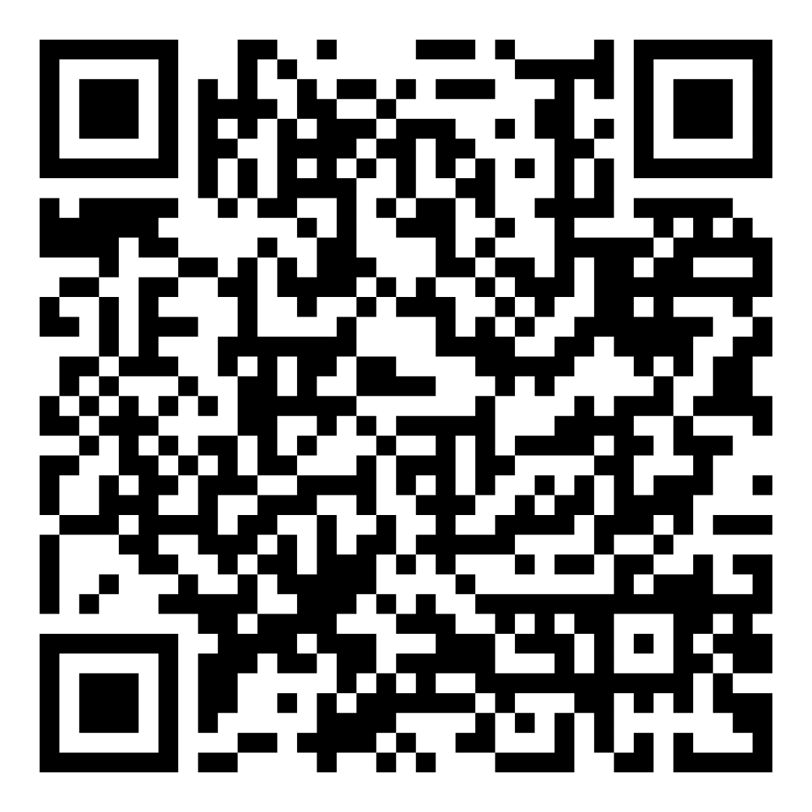

Access the Guideline
www.hivguidelines.org > Second-Line ART After Treatment Failure or for Regimen Simplification
Also available: Printable pocket guide and PDF
Podcast: Viremic—Cases in HIV
Find all episodes at viremic.org

