Slide 1
Clinical Guidance:
Stimulant Use
www.suguidelinesnys.org

Slide 2
Purpose of This Guidance
Inform clinicians about different types of stimulants and current terminology for describing stimulants and their use.
Provide strategies for talking with patients about stimulant use and the associated risks, including opioid overdose due to concomitant use of opioids and stimulants or to contamination of illicitly manufactured stimulants with synthetic opioids.
Summarize the treatment options for stimulant use disorder.

Slide 3
Key Points
Patterns of stimulant use may not be the same in rural and urban areas and may vary across different demographic groups (see Substance Abuse and Mental Health Services Administration: Treatment Improvement Protocol (TIP) 33: Treatment for Stimulant Use Disorders > Treatment Considerations for Special Populations).
Structural and systemic conditions such as violence, racism, stigma, housing insecurity, and chronic stress underlie the prevalence and effects of stimulant use disorder.
All patients who inject stimulants or other substances should be counseled about safer use of drug equipment. Licensed pharmacies, healthcare facilities, and healthcare providers may sell or furnish hypodermic needles or syringes to individuals age ≥18 years without a patient-specific prescription; drug equipment is also available at New York State Authorized Syringe Exchange Sites.

Slide 4
Characteristics of Commonly Used Stimulants:
Cathinone, Synthetic
Characteristics | Patient-Reported Reasons for Use and Slang
Source and forms: Synthetic substance chemically similar to natural cathinone (khat plant); available as a white or brown crystal-like powder; less expensive substitute for cocaine and amphetamines Administration: Intravenous, oral, intranasal insufflation, smoking Onset of action: 30 to 60 minutes (oral) Half-life: 3 to 6 hours | Reasons for use: Produces euphoria and alertness; designed to imitate the effects of other stimulants such as cocaine, MDMA, and methamphetamines Street names: Bath salts, Molly

Slide 5
Characteristics of Commonly Used Stimulants:
Cocaine
Characteristics | Patient-Reported Reasons for Use and Slang
Source and forms: Hydrochloride salt derived from the coca plant; available as a powder. Freebase cocaine (crack) is a form of cocaine boiled with another substance, usually baking soda; available as a powder or rock. Cocaine administration: Intravenous, intranasal insufflation, vaginal or rectal as a solution Freebase cocaine (crack) administration: Can be smoked as a powder or rock; injectable if dissolved in acid solutions such as vinegar (acetic acid) or citric acid Onset of action: Immediate Half-life: 40 to 90 minutes | Reasons for use: Sexual enhancement, attenuate sedation from other substances (heroin, fentanyl, alcohol), mood enhancement, work enhancement, withdrawal avoidance, euphoria Street names: Blow, bump, C, candy, coke, girl, Perico, Piedra, Scotty, rock

Slide 6
Characteristics of Commonly Used Stimulants:
MDMA
Characteristics | Patient-Reported Reasons for Use and Slang
Source and forms: Synthetic; available as tablets, capsules, crystals, powder Administration: Oral, intranasal insufflation, rectal (“boofing”) Onset of action: 20 to 60 minutes Half-life: 8 to 9 hours | Reasons for use: Sexual enhancement, improving depression (including in low doses), interpersonal relationship enhancement (empathogenic effects), co-use or collective use Street names: Ecstasy, Molly, XTC, E, X, Miley Cyrus Slang for use: Raving, rolling, ate up (for long-term use)

Slide 7
Characteristics of Commonly Used Stimulants:
Methamphetamine
Characteristics | Patient-Reported Reasons for Use and Slang
Source and forms: Synthetic; available as a white or clear odorless substance (powder, crystals, or pressed pills) that dissolves easily in water or alcohol Administration: Intravenous, intranasal insufflation, smoked, oral ingestion, vaginal or rectal as a solution Onset of action: Immediate Half-life: 10 hours | Reasons for use: Sexual enhancement, increased work duration and stamina, wakefulness, weight loss, improving depression, withdrawal avoidance, enhancement of other drug effects, improved function and self-image, sensory enhancement Street names: Meth, crank, crystal, ice, Tina, speed, water Slang for use: Tweaking, amping, spun, booty bumping (rectal administration)

Slide 8
Characteristics of Commonly Used Stimulants:
Prescribed: Amphetamines, Amphetamine Derivatives, Methylphenidate, and Other Stimulants
Characteristics | Patient-Reported Reasons for Use and Slang
Source and forms: Synthetic medications that may be prescribed for treatment of ADHD or narcolepsy. Includes: Dextroamphetamine-amphetamine (e.g., Adderall, generics), dextroamphetamine sulfate (e.g., Dexedrine, generics), lisdexamfetamine (e.g., Vyvanse), methylphenidate hydrochloride (e.g., Ritalin, Concerta, generics) Administration: Oral, intravenous, intranasal insufflation Onset of action: 20 to 60 minutes Half-life: 6 to 13 hours (depending on formulation) | Reasons for use: Performance enhancement, weight loss, improving depression, reductions in use of other amphetamines Street names: Addies, bennies, dexies, crank, pep pills, ice, speed, uppers, Superman, vitamin R Slang for use: Speeding, tweaking, spun, amping

Slide 9
Common Adverse Effects
Stimulant Intoxication
Neuropsychiatric: Grandiosity/egocentricity, hypervigilance, paranoia or psychotic symptoms (associated with higher doses), agitation/anxiety, choreoathetosis (abnormal body movements), insomnia, appetite suppression, mydriasis (dilated pupils), tremors, psychomotor agitation (excessive or animated rapid movements)
Cardiovascular: Tachycardia, hypertension, chest pain, palpitations
Constitutional: Hyperthermia, weight loss

Slide 10
Common Adverse Effects, cont.
Chronic Stimulant Use
Neuropsychiatric: Extreme fatigue and disrupted sleep, formication (sensation of bugs crawling on skin), paranoia or psychosis, depression, anhedonia, anxiety/panic attacks, choreoathetosis (abnormal body movements), headache, seizures
Cardiovascular: Heart attack, arrhythmia, myocarditis, hypertensive crisis, heart failure, stroke (ischemic and hemorrhagic), renal infarction, ischemic bowel
Constitutional: Malnutrition, cachexia, extreme weight loss, refeeding syndrome
Respiratory: Chronic obstructive pulmonary disease, pneumonitis (especially with inhalation)
Dermatologic: Secondary skin infections, excoriations (e.g., due to formication)
Dental: Dental carries, teeth loss, gum disease, gingivitis, aphthous ulcers

Slide 11
Talking With Patients About Substance Use
Normalize discussions of substance use by linking them to discussions of tobacco and alcohol use in a nonjudgmental manner.
Ask permission to talk about substance use, e.g., Would it be okay if we discussed this today or during your next visit? I want to be sure to offer you every treatment or service that might be beneficial, help keep you out of harm’s way, and improve your health and well-being.
Proactively destigmatize and normalize conversations about substance use with patients, e.g., Have you ever felt discriminated against because of your drug use? If you experience anything that feels like discrimination here, please let me know.
Avoid making assumptions, ask open-ended and clarifying follow-up questions, as needed, and ask only for information relevant to a patient’s current medical care. Discussing history related to substance use may be difficult for patients and should be asked about once rapport and trust are well established.

Slide 12
Talking With Patients About Substance Use, cont.
Substance use language and terminology change often, and one term may refer to different substances, e.g., “dope” may refer to cannabis or heroin. Ask patients to define any unfamiliar terms and to correct any misuse of terms (see Characteristics of Commonly Used Stimulants).
Some modes of use carry stigma and patients may be reluctant to mention them. If clinicians ask specifically, it may encourage conversation, e.g., How do you use (drug of choice)? Are you injecting, snorting, or smoking? Mode(s) of use inform harm reduction strategies.
The use of substances with sex may increase a patient’s risk of acquiring HIV, hepatitis C virus, and other STIs. Clinicians may ask, e.g., Do you use drugs with sex? Are there any drugs that you use only with sex? How do you use (drug of choice) with sex? Some methods, such as rectal use of methamphetamine or cocaine, are associated with abrasions that increase the risk of exposure to HIV and other STIs during condomless sex.

Slide 13
Key Points:
Stigma
Stigma among clinicians against people who use substances has been well documented and may prevent individuals from seeking or receiving medical care, substance use treatment, and harm reduction services.
The NYSDOH AI evidence-based guideline Substance Use Harm Reduction in Medical Care recommends that clinicians:
  Actively examine their assumptions and decisions for personal bias that may adversely affect their ability to provide effective care for individuals who use substances.
  Use nonjudgmental language that respects individuals’ dignity and avoid language that perpetuates stigma.

Slide 14
Withdrawal
Stimulant withdrawal symptoms may include fatigue, irritability, insomnia, poor concentration, anxiety, depression, and decreased ability to perform daily activities.
Although stimulant withdrawal is not itself life-threatening, symptoms may persist for days or weeks in individuals who have a history of chronic use.
There is also an increased risk of self-harm and suicide due to symptoms of depression and dysphoria related to stimulant withdrawal.

Slide 15
Overdose Prevention Strategies
Counsel patients to:
Assume all illicitly manufactured opioids will contain fentanyl or other high-potency synthetic opioids and that stimulants and counterfeit pills may contain these agents.
When possible, test drugs with fentanyl test strips or other drug-checking strategies.
Try to avoid using drugs alone, and if they have to use alone, arrange for someone to check in or use phone- and web-based apps.
Start with a small amount (low dose) when using any drug.
Carry naloxone (NLX), learn how to use it to reverse an opioid overdose, and encourage friends and contacts to do the same.

Slide 16
Key Points:
Stimulant Use Disorder (StUD)
For patients with StUD, clinicians who are not specialists in substance use treatment are encouraged to:
Discuss harm reduction strategies, including overdose prevention.
Evaluate patient’s readiness to engage in treatment; if ready, collaborate with patient on treatment goals.
Refer patient for behavioral therapy based on availability and patient preference. Evidence indicates that, overall, CM and other behavioral approaches are more effective than pharmacologic treatment for StUD.
Consult with or refer patient to a substance use treatment specialist for pharmacologic treatment.

Slide 17
Medications and Factors to Consider for Stimulant Use Disorder Treatment in Nonpregnant Adults:
Amphetamine or Methamphetamine Use Disorder
Medication(s) | Considerations
Mirtazapine | May also treat co-occurring depressive disorders May reduce stimulant-associated sexual risk behaviors in MSM; may reduce insomnia Adverse effects include weight gain and drowsiness
Injectable XR naltrexone plus XR oral bupropion | May also treat co-occurring AUD, tobacco use, and depression Injectable XR naltrexone is contraindicated in patients taking opioids or experiencing opioid withdrawal symptoms. For all contraindications, see prescribing information.
Bupropion | Consider for treatment of patients with <18 days use per month; may also treat co-occurring tobacco use or depression More effective for treatment of cocaine use disorder than amphetamine use disorder
Methylphenidate (MPH) | Refer patient to an addiction specialist to consider use Consider for treatment of patients who use ≥10 days per month; may also treat co-occurring ADHD May require dosing at or above the maximum FDA-approved dose for ADHD treatment
Topiramate | May also treat co-occurring AUD Adverse effects (brain fog, appetite suppression) limit efficacy

Slide 18
Medications and Factors to Consider for Stimulant Use Disorder Treatment in Nonpregnant Adults:
Cocaine Use Disorder
Medication(s) | Considerations
XR mixed amphetamine salts and topiramate | Refer patient to an addiction specialist to consider use May also treat co-occurring AUD or ADHD
Sustained-release dextroamphetamine | Refer patient to an addiction specialist to consider use May also treat co-occurring ADHD and may require dosing at or above the maximum FDA-approved dose for ADHD treatment
Modafinil | Refer patient to an addiction specialist to consider use Avoid in patients with co-occurring AUD or history of pre-existing or substance-induced psychosis May be particularly helpful in helping a patient achieve abstinence early in treatment or for highly motivated and treatment-adherent patients with frequent use upon treatment initiation
Bupropion | May also treat co-occurring AUD or tobacco use In 2 RCTs, bupropion combined with CBT or contingency management was superior to placebo for sustained abstinence.
Topiramate | May also treat co-occurring AUD Adverse effects (brain fog, appetite suppression) limit efficacy

Slide 19

Need Help?

Slide 20
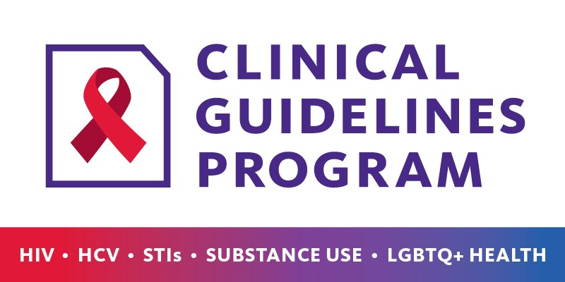
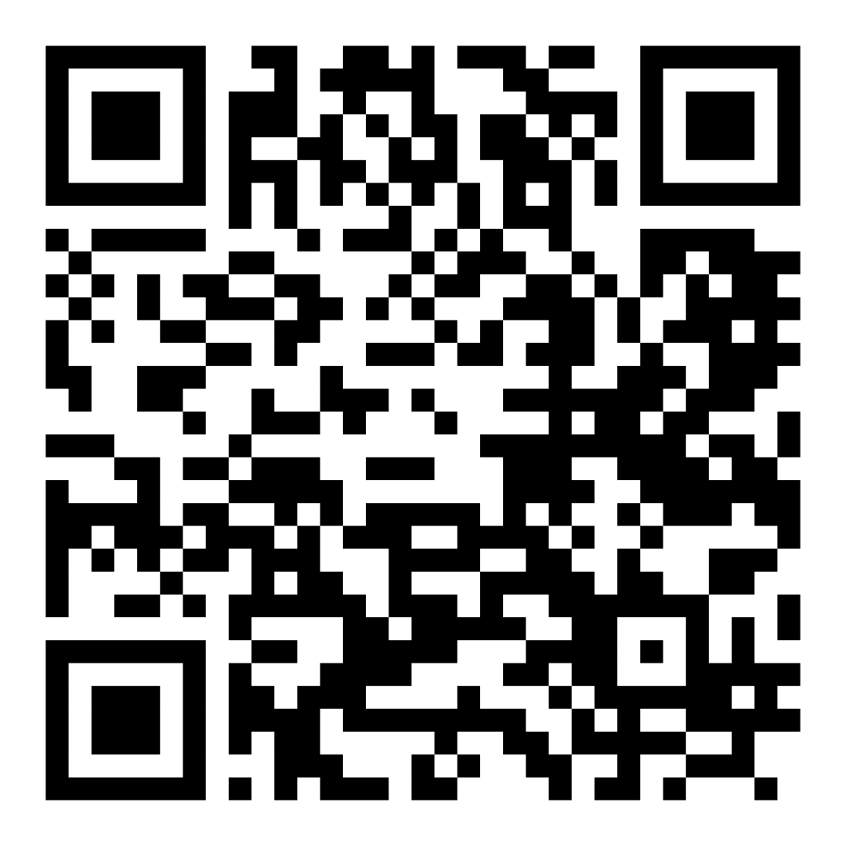
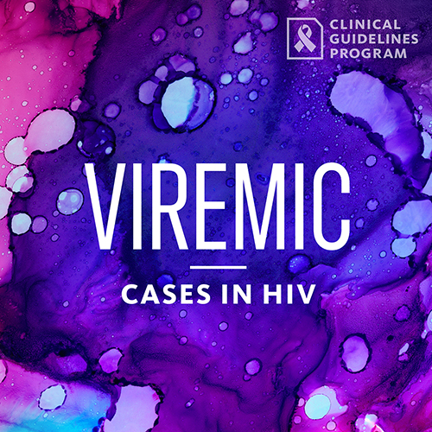
Access the Guidance
www.suguidelinesnys.org > Clinical Guidance: Stimulant Use
Also available: Printable PDF
Podcast: Viremic—Cases in HIV
Find all episodes at viremic.org

