Slide 1
Guidance: Adopting a Patient-Centered Approach to Sexual Health
www.hivguidelines.org

Slide 2
Purpose of This Guidance
Encourage clinicians to adopt a patient-centered approach to sexual health care to improve the health and well-being of people in New York State who receive HIV prevention and care services and prevention and care services related to other STIs
Improve patients’ overall health and well-being, reduce stigma, empower patients, and increase their uptake of sexual health-related resources
Recognize sexual health as an important component of overall health that care providers should address as part of routine health visits

Slide 3
Sexual Health Framework
“Includes ensuring that all people in NYS are empowered to exercise and achieve control over their sexual health and can access sexual health services that promote wellness in a manner that is respectful of their needs. This framework acknowledges sexuality as a life-long endeavor for people of all identities. It recognizes the importance of sexual pleasure, satisfaction, and intimacy to overall health and well-being.”
--AIDS Institute Director Johanne E. Morne, MS

Slide 4
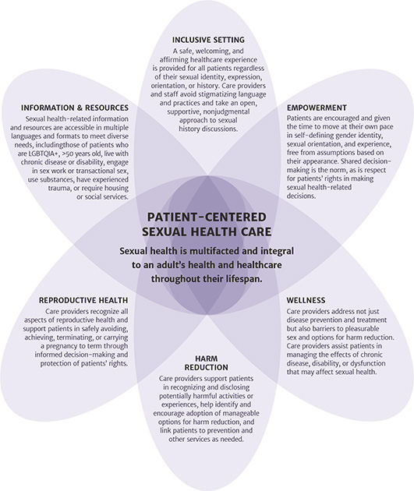
Multifaceted Patient- Centered Sexual Health Care
Sexual health is multifaceted and integral to an adult’s health and healthcare throughout their lifespan
Facets include:
Inclusive setting
Empowerment
Wellness
Harm reduction
Reproductive health
Information and resources

Slide 5
Inclusive Setting
Provide a safe, welcoming, and affirming healthcare experience for all patients regardless of their sexual identity, expression, orientation, or experience
Approach discussions of sexual health and history in an open and nonjudgmental manner
Avoid using stigmatizing language, such as “safe sex” and “high-risk sex”
Take an HIV status-neutral approach to discussions of sexual health
Address structural, racial, socioeconomic, and cultural barriers to sexual health and healthcare

Slide 6
Empowerment
Refrain from making assumptions based on a patient’s age, physical experience, or gender expression
Ask patients to identify their preferred pronouns and then ensure use of these pronouns in addressing patients
Support patients in identifying their sexual identity, orientation, experience and needs; engage in shared decision-making for care planning
Support and encourage patients’ self-efficacy
Provide information that can help reduce stigma and fear, such as information about U=U (undetectable = untransmittable) for patients with HIV
Advocate for patients’ sexual rights, including the right to make sexual health-related decisions

Slide 7
Wellness
Address not just disease prevention and treatment but also barriers to pleasurable sex and options for harm reduction
Assist patients in managing the effects of age, chronic disease, disability, or dysfunction that may affect sexual health
Recognize that the concerns of patients ≥50 years old may differ from those of younger patients
Screen for erectile dysfunction in patients who may be at risk
Provide information and support for patients in achieving intimacy and sexual satisfaction

Slide 8
Harm Reduction
Encourage patients to disclose experiences that may be harmful, including:
Condomless sex
Drug use
Sex with multiple or anonymous partners
Transactional sex
Help identify and encourage adoption of manageable options for harm reduction
Ask open-ended questions about any experience with sexual violence, intimate partner violence, or other types of abuse
Assess access to HIV pre-exposure prophylaxis (PrEP) for patients who do not have HIV
Link patients to prevention and other services as needed

Slide 9
Reproductive Health
Recognize that reproductive health and services are often central to sexual health for patients
Address all aspects of reproductive health, including:
Contraceptive choices for all genders
Linkage to gynecological and obstetric care, abortion services, and other services as needed
Support patients in safely avoiding, achieving, terminating, or carrying a pregnancy to term, such as through:
Informed decision-making and protection of patients' rights
Education about U=U for patients with HIV who wish to conceive with a serodifferent partner

Slide 10
Information and Resources
Ensure accessibility to sexual health-related information and resources in multiple languages and formats to meet diverse needs, including those of patients who:
Identify as LGBTQIA+
Are ≥50 years old
Live with chronic disease or disability
Engage in transactional sex or sex work
Use substances
Have experienced trauma
Require housing, social services, or other specialized services
Have low or no literacy or health literacy
Have limited or no computer or internet access
Require or prefer receiving information via audio or video

Slide 11
Resources for Care Providers
Visit the Adopting a Patient-Centered Approach to Sexual Health guidance for additional resources, including those available from:
New York State Department of Health (NYSDOH) and New York City Health
Centers for Disease Control and Prevention (CDC) and HIV.gov
American Academy of HIV Medicine
American Sexual Health Association (ASHA)
Gay & Lesbian Medical Association (GLMA)
National Coalition for Sexual Health
National Institute on Aging
National LGBTQIA+ Health Education Center
Reproductive Health Access Project and Reproductive Health National Training Center

Slide 12
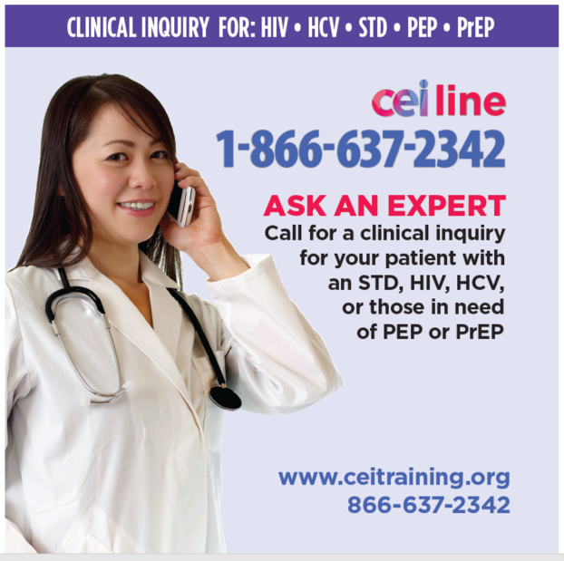
Need Help?

Slide 13
Access the Guidance
www.hivguidelines.org > Guidance: Adopting a Patient-Centered Approach to Sexual Health
Also available: Printable PDF

