Slide 1
Screening for Cervical Dysplasia and Cancer in Adults With HIV
www.hivguidelines.org

Slide 2
Purpose of This Guideline
Increase the number of New York State residents with HIV who are screened for and receive effective medical management of cervical, vaginal, or vulvar dysplasia.
Emphasize the role of ART-associated viral suppression in improving clearance or suppression of HPV, preventing cervical dysplasia, and reducing cervical cancer in individuals with HIV.
Reduce the incident morbidity and mortality associated with genital HPV disease in individuals with HIV through vaccination against HPV and identification and treatment of precancerous lesions, when treatment is most successful, and cancerous lesions.
Support the NYSDOH Prevention Agenda 2019-2024, which aims to increase cervical cancer screening by 5% among individuals who are 21 to 65 years old and have an annual income below $25,000.
Integrate current evidence-based clinical recommendations into the healthcare-related implementation strategies of the New York State Ending the Epidemic initiative.

Slide 3
Recommendation: HPV Prevention
Given the increased lifetime risk of persistent HPV infection and increased prevalence of HPV-related cancers, clinicians should recommend the 9-valent HPV vaccine 3-dose series at 0, 2, and 6 months to all individuals with HIV who are 9 to 45 years old regardless of CD4 cell count, prior cervical or anal screening results, HPV test results, HPV-related cytologic changes, or other history of HPV-related lesions. (A3)

Slide 4
Key Points: HPV Prevention
HPV vaccination status does not change the schedule of cervical cancer screening.
HPV testing is not recommended before administration of the HPV vaccine.
Inform patients with HIV about the risk of acquiring HPV and other STIs from close physical contact with the external genitalia, anus, cervix, vagina, urethra, mouth and oral cavity, or any other location where HPV lesions are present.
Consistent and correct condom use remains an effective way to reduce the risk of transmission of most STIs, including HPV. However, inform patients that barrier protection such as condoms and dental dams may not fully protect against HPV.

Slide 5
Recommendations: Cervical Cancer Prevention
In providing comprehensive primary care for adults with HIV, clinicians should ensure that patients at risk of cervical cancer receive age- and risk-appropriate screening (A3) and provide education about harm reduction measures that may reduce the risk, including:
HPV vaccination (A2)
ART to suppress HIV viral load (A2)
Tobacco use cessation (A2)
Sexual exposure prevention strategies, including using barrier protection (A3) and reducing the number of sex partners and associated sexual networks when possible (A3)
Clinicians should establish a schedule for routine cervical screening based on a patient’s medical history, anatomical inventory, age, and risk profile. (A2)

Slide 6
Recommendations: Screening for Cervical Abnormalities
Clinicians should perform an anatomical inventory to identify patients eligible for screening. (A*)
Clinicians should perform screening for cervical and genital tract dysplasia and cancer in patients with HIV who have or have had a cervix and meet the below criteria for age-based screening. (A2)
Clinicians should perform physical examinations of the vulva, vagina, and anogenital perineum at least annually and at the time of cervical cytology and to assess interval complaints. (A3) Abnormal cytology results may reflect vaginal, vulvar, or anogenital dysplasia in the absence of cervical dysplasia.

Slide 7
Cytologic and Histologic Classifications of Cervical Dysplasia
Bethesda Classification System (describes cervical cytology results) | Cervical intraepithelial lesion or neoplasia (describes histology obtained at biopsy)
Negative for intraepithelial lesion or malignancy (NILM) Atypical squamous cells of undetermined significance (ASC-US) Atypical squamous cells, high-grade squamous intraepithelial lesion cannot be excluded (ASC-H) Atypical glandular cells (AGC): endocervical cells, endometrial cells, or glandular cells Atypical glandular cells not otherwise specified (AGC-NOS) Atypical glandular cells favoring neoplasia (AGC-FN) Low-grade squamous intraepithelial lesions (LSIL) High-grade squamous intraepithelial lesions (HSIL) Squamous cell carcinoma Cancer | Atypia Low-grade cervical intraepithelial neoplasia (CIN 1) Moderate-grade cervical intraepithelial neoplasia; may be a low-grade or high-grade lesion (CIN 2) High-grade cervical intraepithelial neoplasia (CIN 3) Carcinoma in situ (CIS) Endocervical carcinoma in situ Cancer

Slide 8
Recommendations: Age-Based Screening
For patients <30 years old, testing for HPV is not recommended (A2†). For these patients, clinicians should perform cervical cytology within at least 2 years of the onset of receptive sexual activity or by age 21 years, regardless of the mode of HIV acquisition (A2), and if cytology results are normal, repeat testing every 3 years. (A2)
For patients ≥30 years old, clinicians should perform cytology/HPV cotesting within 3 years of previous testing. (A2) If the baseline cytology and HPV test results are negative, clinicians should repeat both tests every 3 years thereafter. (A2)
Clinicians should repeat cervical cytology after 2 months but within 4 months after a result of “insufficient specimen for analysis” has been reported. (A3)
Clinicians should continue cervical cancer screening for patients ≥65 years old; however, factors such as a patient’s life expectancy and risk of developing cervical cancer should inform shared decision-making regarding continued screening. (A3)

Slide 9
Key Points: Who to Screen
Compassionate engagement in shared decision-making is crucial when navigating extended screening intervals or discontinuation of screening based on a patient’s lifetime prognosis. When engaging patients in shared decision-making regarding screening intervals, consider duration of HIV infection, viral load and CD4 cell count over time, and history of abnormal Pap test results and anogenital HPV lesions.
Cervical screening every 5 years may benefit virally suppressed patients adherent to HIV and primary care with negative cytology and negative HPV test results, no genital or pelvic complaints, no tobacco use, and no other cervical cancer risk factors.
Inclusive and culturally sensitive healthcare includes a safe and welcoming environment that acknowledges the needs of transgender, transmasculine, transfeminine, and nonbinary patients.
Ask patients to provide details about all gender-affirming and gynecologic surgical procedures they have undergone to help inform screening for HPV-related cancers.
To facilitate accurate interpretation of cell morphology, note testosterone use and the presence of amenorrhea in the requisition for cervical cytology in transgender men.
In individuals ≥30 years old, cytologic surveillance alone is acceptable only if HPV cotesting is unavailable. Cytology is less sensitive than HPV testing for detection of precancer and, therefore, requires testing at shorter, more frequent intervals. It is recommended that clinicians without access to HPV cotesting offer cytology at a minimum of 3-year intervals.

Slide 10
Recommendations: Concomitant Screening for Anal Cancer and STIs
Clinicians should perform concomitant anal cytology. If appropriate follow-up of abnormal results is not available within the clinician’s institution, a referral plan should be in place.
Regardless of a patient’s cervical cytology results, clinicians should perform routine STI screening.

Slide 11
Recommendations: Post-Hysterectomy Cancer Screening
In patients with an intact cervix, clinicians should perform cervical cytology as above [a]. (A*)
In patients with HIV who have undergone total hysterectomy (uterus and cervix removed), clinicians should screen for vaginal intraepithelial neoplasia by performing vaginal cytology with HPV cotesting and manage as noted under “age-based screening” above. (A2†)
If a patient’s hysterectomy was performed to treat HSILs, CIN 2 or CIN 3, or AIS [a], clinicians should perform 3 consecutive annual HPV tests, after which long-term surveillance should be initiated, with HPV testing every 3 years for 25 years. (A3)

Slide 12
Recommendation: Post-Cervical Excision HPV Testing
After a patient has undergone cervical excision, clinicians should perform cervical cytology with HPV testing as follows: at 6 months post-excision, annually until 3 sequential negative test results have been obtained, and every 3 years thereafter for at least 25 years. (A3)

Slide 13
Recommendations: Screening for Cervical Dysplasia During Pregnancy
Clinicians should perform cervical cytology screening for pregnant patients with HIV as appropriate for each patient’s age. (A2†)
Clinicians should refer pregnant patients for follow-up with experienced colposcopy providers when the following cervical cytology results are obtained: repeated ASC-US, ASC-US with HPV, negative cytology with persistently positive HPV, ASC-H, or LSIL or greater. (A3)
When cervical dysplasia is diagnosed, clinicians should ensure that patients understand the potential risks and benefits and engage pregnant patients in shared decision-making regarding treatment. (A3)
Clinicians should follow up on abnormal cytology or colposcopy results, ideally within 6 weeks postpartum. (A2)
Key Point: Although cervical biopsies are not routinely recommended in pregnancy, any lesion suspicious for carcinoma in situ or cancer merits immediate evaluation with biopsy.

Slide 14
Recommendations: Follow-Up of Abnormal Cervical Cytology Results
When a cervical cytology result of ASC-US is returned for a patient <30 years old or for a patient ≥30 years old who did not receive cotesting, the clinician should perform reflex HPV testing. (A2)
If the reflex HPV test result is positive, the clinician should refer the patient for colposcopy. (A2)
If the reflex HPV test result is negative, the clinician should repeat both the cervical cytology and HPV testing at 1 year. (A2)
If at 1 year the cervical cytology and HPV test results are negative, the clinician should resume standard cervical cytology testing every 3 years. (A2)
If at 1 year the cervical cytology result indicates ASC-US and the HPV test result is negative, the clinician should repeat cervical cytology and HPV testing 1 year following (A3); alternatively, if the patient has a history of cervical dysplasia or individual risk factors for cervical cancer, the clinician should refer for colposcopy. (A3)
If at 1 year the HPV test result is positive, the clinician should refer the patient for colposcopy. (A2)
When a patient of any age with HIV has a cervical cytology result of LSIL, HSIL, ASC-H, AGC, or AIS, the clinician should refer for colposcopy regardless of the HPV test result. (A2)

Slide 15
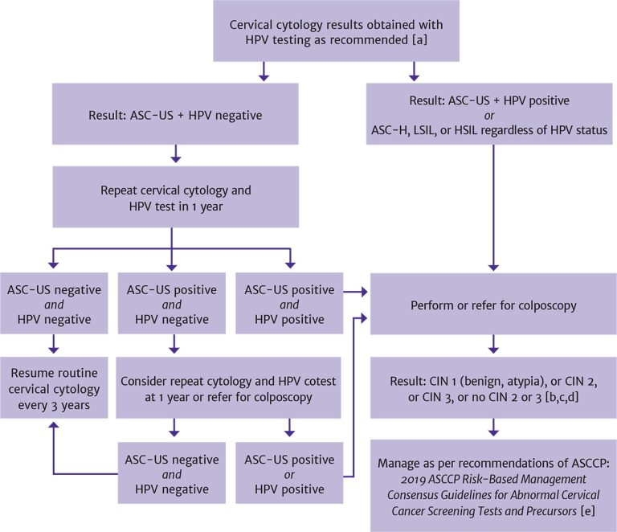
Follow-Up for Abnormal Cervical Cytology Results in Patients With HIV
In patients <30 years old, HPV reflex testing should be performed in patients with a positive cervical cytology result; in patients ≥30 years old, HPV cotesting is recommended.
If cotesting was not performed, then HPV reflex testing is indicated following an abnormal cytology result.
For non–high-grade CIN, refer to ASCCP recommendations for management of LSIL (CIN 1) preceded by ASC-H or HSIL cytology.
In patients <25 years old, immediate excision is not recommended; in nonpregnant patients ≥25 years old, the decision regarding expedited treatment versus colposcopy with biopsy should be based on shared decision-making between the patient and clinician.
Perkins RB, Guido RS, Castle PE, et al. 2019 ASCCP risk-based management consensus guidelines for abnormal cervical cancer screening tests and cancer precursors. J Low Genit Tract Dis 2020;24(2):102-131. [PMID: 32243307]

Slide 16
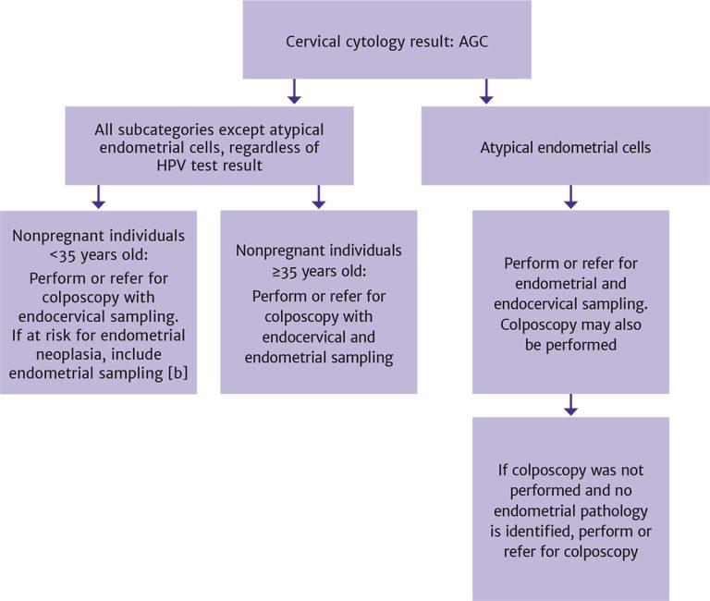
Follow-Up for Cervical Cytology Result of AGC in Patients With HIV [a]
Adapted with permission from the ASCCP. See Perkins RB, Guido RS, Castle PE, et al. 2019 ASCCP risk-based management consensus guidelines for abnormal cervical cancer screening tests and cancer precursors. J Low Genit Tract Dis 2020;24(2):102-131. [PMID: 32243307]
Conditions that increase risk for endometrial neoplasia include abnormal uterine bleeding, obesity, or conditions suggesting chronic anovulation.

Slide 17
Key Points: Follow-Up of Abnormal Cervical Cytology Results
Any cervical cytology result of AGC requires immediate follow-up with colposcopy and further evaluation.
This committee strongly encourages all facilities that provide medical care for patients with HIV to develop a clinical pathway for the screening, diagnosis, and treatment of abnormal anal cytology results.

Slide 18
Recommendations: Management of Cervical Cancer
Clinicians should immediately refer patients with HIV and a diagnosis of cervical cancer to a gynecologic oncologist or surgeon trained in the management of cervical cancer. (A*)
Clinicians should closely monitor patients with a history of cervical cancer with possible consultation with a gynecologic oncologist after definitive treatment for cancer, which may include surgery, radiation, and chemotherapy. (A3)

Slide 19
Need Help?

Slide 20
Access the Guideline
www.hivguidelines.org > Screening for Cervical Dysplasia and Cancer in Adults With HIV
Also available: Printable pocket guide and PDF

