Slide 1
Screening for Anal Dysplasia and Cancer in Adults With HIV
www.hivguidelines.org

Slide 2
Purpose of This Guideline
Increase the numbers of NYS residents with HIV who are screened and effectively treated for HPV-related anal and perianal dysplasia.
Support the NYSDOH Prevention Agenda 2019-2024 by educating care providers on the importance of HPV vaccination and increasing the rate of 3-dose HPV immunization among individuals with HIV.
Reduce the morbidity and mortality associated with HPV-related anal and perianal disease in individuals with HIV through early identification and treatment of potentially precancerous and cancerous lesions, when treatment is most likely to be effective.

Slide 3
Key Points: HPV-Related Anal Disease in Individuals With HIV
Infection with more than 1 HPV type occurs more frequently among individuals with HIV, and such individuals can be at risk for cervical, vulvar, and perianal or anal SILs.
The absence of HPV-related cervical disease in the genital tract does not eliminate the need to screen for anal dysplasia in women with HIV who are ≥35 years old.

Slide 4
Recommendation: HPV Prevention
Given the increased lifetime risk of persistent HPV infection and increased prevalence of HPV-related cancers, clinicians should recommend the 9-valent HPV vaccine 3-dose series at 0, 2, and 6 months to all individuals with HIV who are 9 to 45 years old regardless of CD4 cell count, prior cervical or anal screening results, HPV test results, HPV-related cytologic changes, or other history of HPV-related lesions. (A3)

Slide 5
Key Points: HPV Prevention
It is important that clinicians inform patients with HIV about the risk of acquiring HPV and other STIs from close physical contact with the external genitalia, anus, cervix, vagina, urethra, mouth and oral cavity, or any other location where HPV lesions are present.
Consistent and correct condom use remains an effective way to reduce the risk of transmission of most STIs, including HPV. However, it is important that clinicians inform patients that barrier protection, such as condoms and dental dams, may not fully protect against HPV.

Slide 6
Recommendations: Screening for Anal Disease
For all patients with HIV ≥35 years old, regardless of HPV vaccination status, clinicians should:
Inquire annually about anal symptoms, such as itching, bleeding, palpable masses or nodules, pain, tenesmus, or a feeling of rectal fullness. (A2)
Perform a visual inspection of the perianal [a] region. (A3)
Provide information about anal cancer screening and engage the patient in shared decision-making regarding screening, including anal cytology before DARE. (A3)
Perform DARE annually and whenever anal symptoms are present. (A*)
For adults ≥35 years old who have HIV and are men who have sex with men (A3), transgender women (A3), women (B3), or transgender men (B3), clinicians should perform or recommend annual (A3) anal Pap testing to identify potentially cancerous cytologic abnormalities.
Clinicians should promote smoking cessation for all patients with HIV, especially those at increased risk for anal cancer. (A3)
For all patients with HIV ≥35 years old, clinicians should recommend and perform annual DARE to screen for anal pathology. (B3)

Slide 7
Recommendations: Screening for Anal Disease, continued
Clinicians should evaluate any patient with HIV <35 years old who presents with signs or symptoms that suggest anal dysplasia. (A3)
Clinicians should conduct HRA and histology (via biopsy) for any patient with LSILs or HSILs or refer as needed. (A2)
For patients with anal cytology results indicating ASC-US, clinicians should perform HPV testing (A2):
If HPV testing is available and results are negative, repeat anal cytology in 1 year. (A3)
If HPV testing is available but reflex testing is not available, perform HPV test at follow-up within 6 months. (B2)
If positive for high-risk HPV or if HPV testing is not available, refer for HRA. (B2)
Clinicians should refer patients with suspected anal cancer determined by DARE or histology to an experienced specialist for evaluation and management. (A3)
Clinicians should discontinue screening for anal cancer when life expectancy is less than 10 years and in individuals with 2 consecutive negative anal cytology specimens who are not currently sexually active. (B3)

Slide 8
Key Points: Rationale for Screening
Inform patients about the objective of anal cancer screening and risk prevention. It is important to discuss the specifics of the screening procedure and identify patient preferences to support informed decision-making about screening.
Lower rates of anal cancer screening for people of color have been described and represent inequities in health care.
Missed opportunities for screening and prevention have been documented in 44% of individuals with anal cancer.
The absence of high-risk HPV in the anal canal is associated with a low risk of high-grade dysplasia and anal cancer.

Slide 9
Performing an Anal Cytology Test
Perform an anal cytology test before using swabs for other STI testing, using lubricant, or performing DARE.
A moistened nylon or polyester swab may be used to obtain an anal cytology sample according to the laboratory authority’s collection instructions (cotton swabs should not be used).
For detailed instructions, see University of California San Francisco Anal Cancer Information > Obtaining a specimen for anal cytology.
Instruct patients to refrain from performing an anal enema or douche, engaging in anal sex, or inserting any objects into the anus for 24 hours before cytologic screening.

Slide 10
Key Points: Digital Anorectal Examination (DARE)
In individuals with HIV, assessment for visible anogenital HPV lesions is part of the annual physical examination.
If a DARE is performed with anal cytology or HRA, clinicians should obtain the cytologic sample before introducing lubrication into the anal canal. Lubrication may affect the ability to obtain an adequate cytologic sample. DARE may also cause bleeding, which can contaminate the cytologic sample.

Slide 11
Recommendations: Follow-Up of Abnormal Anal Cytology Results
Clinicians should refer patients with abnormal anal cytology results to a care provider with experience performing HRA and follow up as indicated in Follow-Up of Anal Cytologic Screening Results. (A3)
Clinicians should perform a cervical cytology test (Pap test) for any individual who is not up to date with current cervical screening guidelines. (A3)

Slide 12
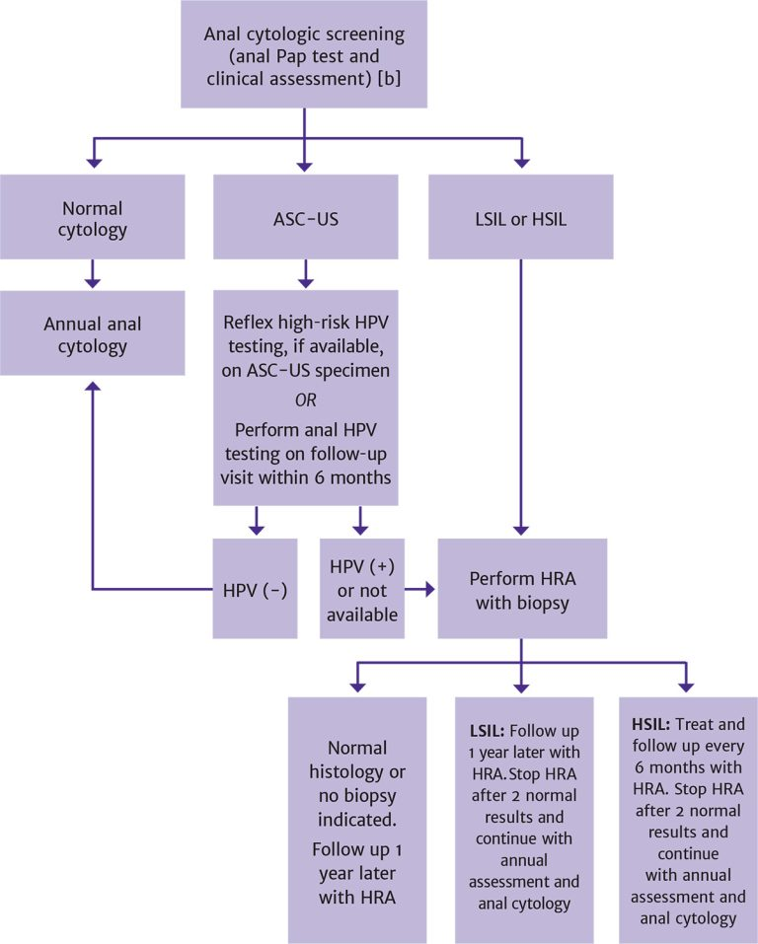
Follow-Up of Anal Cytological Screening Results [a]
The figure describes recommended screening and follow-up for the following individuals with HIV who are ≥35 years old: men who have sex with men, women, transgender men, and transgender women.
Continued annual clinical assessment and anal cytology, with annual HRA, is recommended for patients with a history of HSILs as long as life expectancy exceeds 10 years.

Slide 13
Recommendations: Anal HSILs
Clinicians should perform post-treatment follow-up with repeat HRA at 6 months in patients who have been successfully treated for anal HSILs or should refer patients for this follow-up. (A3)
Clinicians should base follow-up after a patient’s first post-treatment HRA and biopsy on the most recent histopathology findings (see Follow-Up of Anal Cytologic Screening Results). (A3)
Clinicians should continue annual clinical assessment and anal cytology, with annual HRA for patients with a history of HSILs, as long as life expectancy exceeds 10 years. (A3)

Slide 14
Recommendations: Anal Cancer
Clinicians should immediately refer patients diagnosed with anal cancer to an oncologist or surgeon trained in the management of anal cancer. (A2)
Clinicians should closely monitor patients with anal cancer in collaboration with the oncologist after definitive treatment for cancer. (A3)

Slide 15
Need Help?

Slide 16
Access the Guideline
www.hivguidelines.org > Screening for Anal Dysplasia and Cancer in Adults With HIV
Also available: Printable pocket guide and PDF

